Slide 1




2025 Annual Heatropolis Horizon Scan
April 2025
1

Slide 2
Horizon Scan Contents
Introduction to Horizon Scan
Heat Network Deployment
Relevant Projects & Studies
UK Policy & Regulatory Landscape

Slide 3
Introduction to Horizon Scan

Slide 4

Horizon Scan Purpose & Outline
Document Purpose
The purpose of this document is to track projects, policies, market design and regulation relevant to Heatropolis. Heatropolis Beta Phase will run over four years which could see policy and regulatory changes regarding many areas relevant to the project delivery, such as heat network regulation and roll out. To ensure the solutions Heatropolis tests reflect reality, it is important to keep up to date with current and upcoming developments.
In addition, there are many projects working on different aspects of the electrification of heat, flexibility and commercial arrangements, and this Horizon Scan will ensure Heatropolis takes on learnings from other such projects and countries to avoid duplication of effort. It will also enable the identification of opportunities for dissemination and knowledge sharing with other projects who could benefit from Heatropolis learnings.
This document gives an overview of the state of heat network deployment and decarbonisation in the UK. It then identifies and documents relevant projects in the UK and Europe including approach, outcomes and key relevant learnings. Finally, it provides an overview of current and upcoming relevant regulation and policy in the UK and analyses the potential impacts of these.

Slide 5
Horizon Scan Methodology
Over the course of each year, we will maintain a database of news articles, announcements, and key documents to compile into the annual Horizon Scan, ensuring we are building a strong pipeline of content and spreading the effort. We will employ the research approach depicted on the right to feed the database.
Research Approach
Desk based research
We will use a search engine to look up projects using key words “heat networks”, “flexibility”, “thermal storage”, etc.
We will also target specific websites for relevant content, such as the ENA portal, ADE website and energy news sites like Utility Week and Energy UK.
Stakeholder inputs
Project partners will contribute to the database of relevant news and projects, especially where they have industry specific or expert knowledge that other partners may not have access to otherwise. We will also note any insights from external stakeholder engagements.
Collect information about news, updates and new projects into the Horizon Scan database throughout the year.
Review the database and ask the project partners and any key external stakeholders for further inputs.
Draft the annual Horizon Scan, as well as new projects and news, it should include updates on ongoing projects which were identified in previous iterations of the Horizon Scan.
Send annual Horizon Scan to the project partners for review.
Finalise and disseminate, applying learnings to other work packages.
Year ahead
3 months ahead
Newsletters
By signing up to newsletters from key organisations and news outlets, we will ensure we receive industry updates as they arise and add them to the database.
Conferences and webinars
Representatives from the project team will attend any relevant presentations, webinars and conferences (e.g. ADE heat networks forum) throughout the year and share relevant learnings with the wider project team, feeding into the Horizon Scan where appropriate.
2 months ahead
1 month ahead
Horizon Scan due

Slide 6
Horizon Scan Coverage
As well as an overview of the current state of heat network deployment in the UK, the Horizon Scan covers two main areas.
Innovation projects from the UK and abroad
UK policy and regulation
This includes the following:
The scope and themes of projects covered
A list of the projects covered (17 in this iteration)
Project deep dives for more information
This includes the following:
Current and upcoming heat network regulations and policies
Past, present and upcoming heat network consultations
Heat network funding schemes

Slide 7
Heat Network Deployment

Slide 8
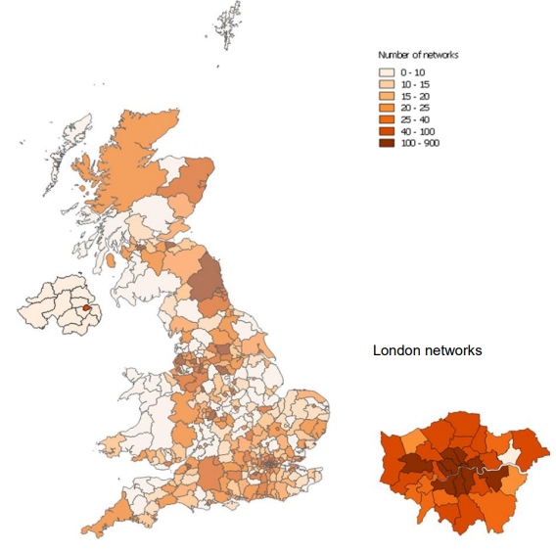
Current State
There are currently approximately 14,000 heat networks in the UK, providing heat to approximately 480,000 consumers, or approximately 3% of the UK’s current heat demand. According to the ADE, ~91% of the UK’s heat networks are in England, and ~6% are in Scotland.
This data dates from 2018, when DESNZ (then known as BEIS) commissioned The National Measurement and Regulation Office to collect and analyse the data submitted by heat network suppliers when the Heat Network (Metering and Billing) Regulations came into force in 2014. Updated statistics from the reporting requirements have not been published since that report. It is interesting to note that 3,000 notifications were excluded due to missing data, suggesting the 14,000 number is an underestimate, and the actual number may be closer to 17,000.
The most frequently updated data source is DESNZ’s Heat Networks Planning Database, which is updated on a quarterly basis and tracks the progress of communal and district heat networks from inception to planning, construction, operation and decommissioning. The database has been going since 2021 and the most recent version contains 1100 rows, less than 10% of the total number of heat networks in the UK
Split of heat network consumers
Split of heat network by type*
Consumer Type | Number | %
Domestic | 439,549 | 92.2%
Commercial | 28,054 | 5.9%
Retail | 3,226 | 0.7%
Light industrial | 217 | 0.05%
Industrial | 77 | 0.02%
Education | 1,164 | 0.2%
Public | 602 | 0.1%
Other | 4,062 | 0.9%
2,087 (15%)
11,908 (85%)
Communal
District
Number of heat networks by local authority, source: BEIS 2018
*District is more than one building, while communal is only one building. It is therefore important to note that the majority of heat networks in the UK are a “Heatropolis archetype 3”.

Slide 9
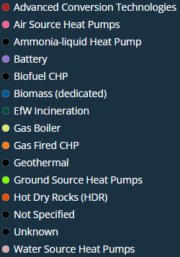
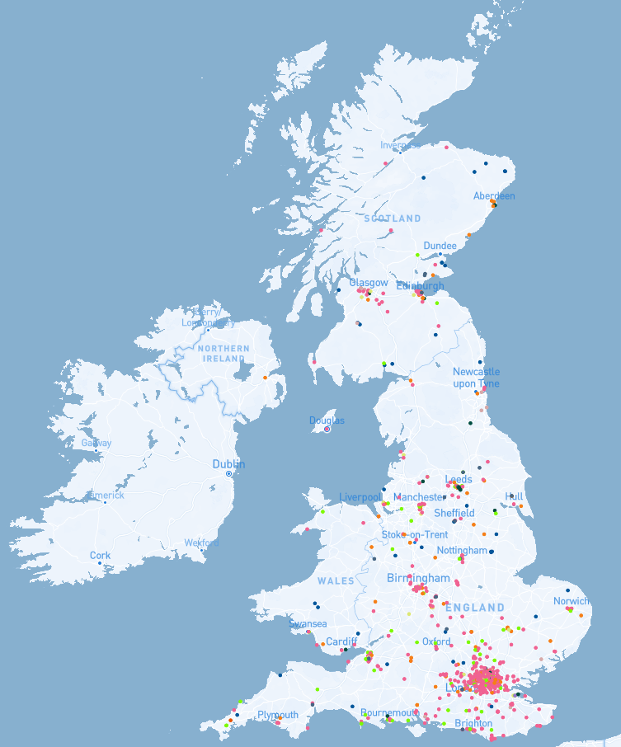
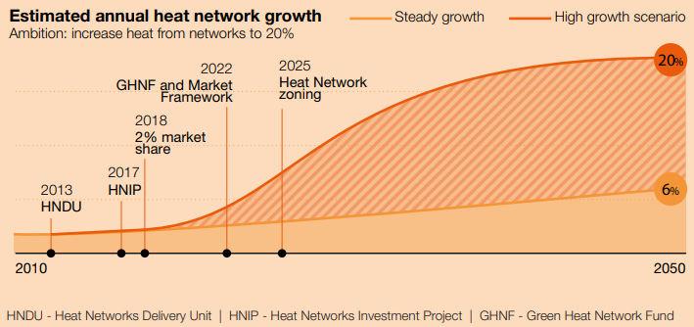
Targets and Pipeline
Deployment of new heat networks
The government is aiming for 20% of the UK’s heat demand to be provided by heat networks by 2050. This represents an increase from 12.8 TWh in 2020 to 95 TWh in 2050. Many do not believe this is ambitious enough, including the latest Carbon Budget whose Balanced Pathway sees heat networks providing 22% of heat in non-residential buildings by 2040, and assumes that the deployment of heat networks in the residential sector will match the non-residential rate.
Decarbonisation of existing heat networks
90% of existing heat networks use at least some natural gas. The Seventh Carbon Budget set out ambitious milestones for 40% of existing heat networks to be decarbonised by 2030, and 100% by 2040 in the Balanced Pathway. UK Government is supporting this through various funds (slide 40).
Proportion of heat demand met by heat networks over time, source: DESNZ
Map of heat networks in development as of Q3 2024, source: Barbour-ABI

Slide 10
Relevant Projects & Studies

Slide 11



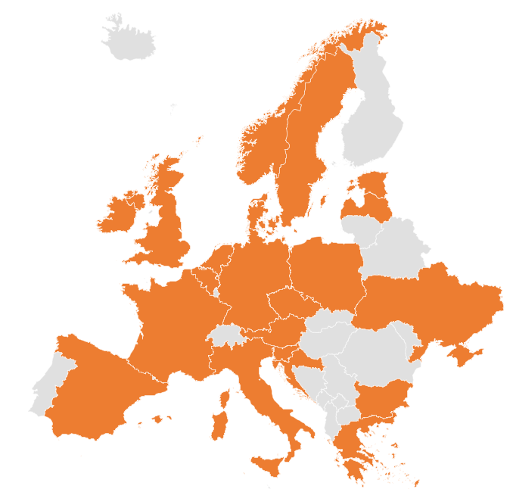
Project coverage: key themes and geographic scope
Geography
Key Themes
Heatropolis is a UK based project, therefore this Horizon Scan focuses on the UK, as well as large-scale projects in Europe as these markets are sufficiently similar to draw valuable learnings. This iteration of the Horizon Scan includes projects across 21 countries.
Flexibility
The Horizon Scan includes projects looking at flexibility from the electrification of heat, especially in relation to heat networks, although one project on flexibility from individual heat pumps has also been included due to its relevance to large scale trials involving end customers.
Storage
Projects looking at the use of different types of energy storage technologies with heat networks have been included as storage is a key part of the Heatropolis solution. Most are looking at the use of storage for optimisation of heat loads and flexibility, which is highly relevant to Heatropolis.
Decarbonisation
The final theme is projects focused on the decarbonisation of existing heat networks. This range from strategies to increase renewable energy and waste heat sources to whole system approaches improving the integration between heat, electricity and gas networks to accelerate decarbonisation.

Slide 12
List of relevant projects (1/2)
# | Project | Country | Organisation(s) | Description
1 | Heat networks as flexible grid assets | UK | Minibems, Evinox | Part of UKRI’s Industrial Strategy Challenge Fund. aimed to use heating demand variability and the inherent heat storage of buildings to allow heat networks to benefit from energy price variability and provide flexibility.
2 | Storage and Flexibility Net Zero Series: Thermal Energy Storage for Heat Networks | UK | Energy Systems Catapult | Reviewed existing and innovative thermal storage technologies and investigated policy and regulatory barriers to TES alongside DHNs. An Excel-based modelling tool was developed and used to assess the feasibility of TES in DHNs.
3 | ThermaFLEX | Austria | AEE INTEC + partners | Aims to develop strategies and measures for making heat networks more flexible and increase the proportion of renewable heat used.
4 | Flex Heat Networks | UK | UKPN | The project aims to explore the impact of fully or almost fully electric heat networks on the power grid and how to manage them flexibly.
5 | Enable DHC | 9 European countries | Ambiente Italia + partners | Objective is to develop an enabling framework for the diffusion of low-carbon, efficient, resilient and sustainable District Heating and Cooling systems.
6 | THUNDER | UK + multiple EU countries | RINA + partners | The THUNDER project aims to overcome existing barriers hampering a wide adoption of DCs waste heat recovery strategies, providing an innovative, efficient and cost attractive Seasonal Thermal storage based on Thermochemical Materials.
7 | TREASURE | Multiple EU countries | AEE INTEC + partners | Demonstrating large pit thermal energy storages and improving their components, processes and procedures for an accelerated realisation of 100% sustainable district heating networks in Europe.
8 | USES4HEAT | 6 European countries | KTH Royal Institute of Technology + partners | Underground Large-Scale Seasonal Energy Storage for Decarbonized and Reliable Heat.
9 | RE-PEAK | Multiple EU countries | Energie Institut, Tal Tech, Euroheat & Power | The transition of heat networks must be supported by a better understanding of the challenges and options associated with peak heat loads.
10 | SENERGY-NETS | Multiple EU countries | European Institute for Energy Research + partners | SENERGY-NETS will develop a set of tools and platforms (up to TRL7/8) aimed to optimise the planning of District Heating and Cooling as well as distribution grids with sector coupling consideration and allow the provision of flexibility services to Distribution and Transmission System Operators.

Slide 13
List of relevant projects (2/2)
# | Project | Country | Organisation(s) | Description
11 | Aberdeen Heat & Power | UK | Aberdeen Heat & Power, Flexitricity | Pioneering district heating project uses Capacity Market revenue to support their mission of alleviating fuel poverty.
12 | Magnitude | UK + multiple EU countries | EDF + partners | Aims to identify potential flexibility options coming from synergies between the electricity, heating, cooling and gas networks.
13 | Gateshead District Energy Scheme | UK | Gateshead Council, Flexitricity | Working with Flexitricity since 2016, became the first I&C customer to enter the Balancing Mechanism.
14 | IEA Technology Collaboration Programme Annex 57 | Multiple EU countries | Heat Pumping Technologies | Flexibility by implementation of heat pumps in multi-vector energy systems and thermal networks.
15 | Flexi-Sync | Multiple EU countries | Swedish Environmental Research Institute + partners | Aims to optimise the flexibility in the district energy sector, a sector with untapped potential to balance the energy system.
16 | Whole system value of electrified district heating networks in decarbonising heat sector in the UK | UK | Newcastle University | Study assessing the whole-system value of using centralised heating technologies to supply a portion of heat demand in the UK in 2035, in contrast to decentralized electrified heat supply.
17 | EQUINOX | UK | National Grid + partners | This project aims to develop novel commercial arrangements and supporting technologies that unlock flexibility from residential low carbon heating (heat pumps), while meeting the needs of all consumers, including the fuel poor and vulnerable.

Slide 14



1. Heat networks as flexible grid assets
Project Overview
Description: UKRI funded projects aimed to use heating demand variability and the inherent heat storage of buildings to allow heat networks to benefit from energy price variability and provide flexibility. More info.
Countries: United Kingdom
Organisations:
Dates: April 2020 – December 2021
Outcomes
The project showed how enhanced energy management systems for heat networks could use the way buildings heat up and cool down to flex heating demand, increase efficiency and deliver benefit from cost savings. It demonstrated the savings that could be achieved by load shifting the heating demand. In March 2023, heat network control company Minibems merged with heat network equipment supplier Evinox to advance their position in the energy-efficient heat networks sector.
Approach
Used Minibems’ real-time data driven control capability to innovate on ways to provide load shifting options.
Learnings for Heatropolis
This project provides evidence that cost savings can be achieved through shifting the demand profile to times of lower energy costs, using the thermal mass of the building and enhanced controls alone. Little information is publicly available so WP7 should consider engaging with Evinox to further understand key learnings and if this solutions has been rolled out beyond the project.
Relevant themes
Notes:
https://www.evinox.co.uk/about-evinox/

Slide 15
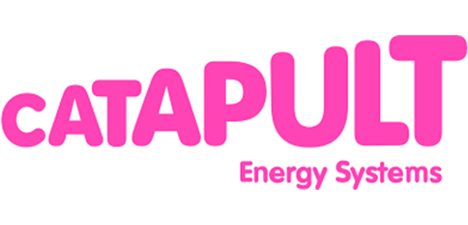

2. Storage and flexibility: thermal energy storage for heat networks
Project Overview
Description: As part of the Innovating to Net Zero programme, Energy Systems Catapult looked into existing thermal storage technologies and investigated their feasibility alongside heat networks. More info.
Countries: United Kingdom
Organisations:
Dates: 2020
Outcomes
The project produced a series of policy recommendations to overcome barriers to using thermal storage within heat networks, including increased R&D support, clear guidance for the design and planning of thermal storage within heat networks, and improved cross-vector integration of heat and power systems. Key barriers to deployment of thermal storage were identified as high investment costs, space constraints and customer acceptance.
Approach
Reviewed existing and innovative thermal storage technologies and investigated policy and regulatory barriers to the deployment of thermal energy storage alongside heat networks. Developed an Excel-based modelling tool to assess the feasibility of thermal storage in heat networks.
Learnings for Heatropolis
This project provides evidence that high investments costs are currently a barrier to thermal storage in heat networks, supporting the case that further incentives such as flexibility payments would be required for heat networks to do this. Centrally located thermal storage can also provide value to heat networks by reducing the size of heat generation needed. In terms of different types of thermal storage, this project found that while sensible heat thermal energy storage (e.g. hot water tanks) is cost effective, at small capacities where space is a premium, latent heat thermal energy storage (phase-changing material-based) could be cost competitive or even comparable.
Relevant themes

Slide 16
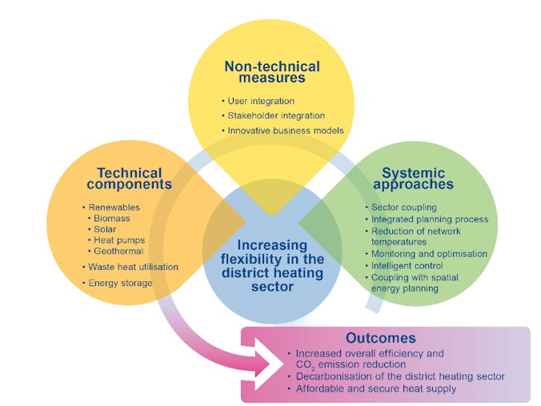
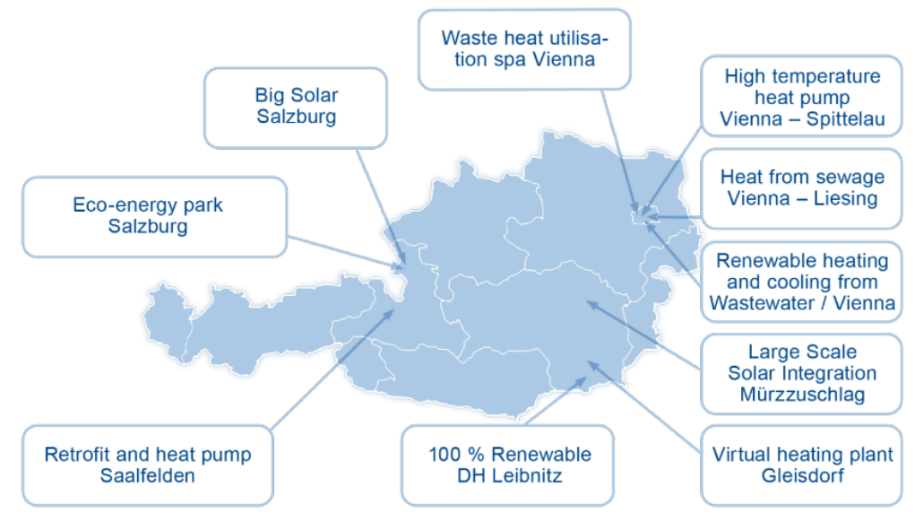

3. ThermaFLEX
Project Overview
Description: Aims to develop strategies and measures for making heat networks more flexible and increase the proportion of renewable heat used. More info.
Countries: Austria
Organisations: Consortium leader
Dates: November 2018 – October 2022
28 partners from the energy industry, R&D and technology providers
Outcomes
The project delivered a set of Best Practices outlining promising measures and demonstrating the technical, economic and ecological benefits of the concepts. The measures deployed resulted in a significant increase in the share of renewable energy, as well as the decarbonisation and diversification of the demonstrator heat networks. The project demonstrated the feasibility of implementing large-scale solutions within relatively short timeframes.
Approach
Every fourth house in Austria is already supplied by a heat network so a key driver for the project was ensuring heat supply remains affordable, secure and resilient. The project focused on 10 demonstrator heat networks in Austria to test and evaluate various technical, non-technical and systemic measures. The project utilised a wide range of heat sources and flexibility elements, with a central emphasis on heat storage, energy sector and infrastructure coupling, smart control concepts, large-scale heat pumps, solar thermal energy, and the utilisation of locally available heat and waste heat sources. Note that, in this case, flexibility does not refer purely to electric load shifting but more broadly to the ability to adapt to different heat sources, smart controls, operating temperatures and conditions.
Learnings for Heatropolis
ThermaFLEX provides wide technical and non-technical knowledge for the flexibilisation of heat network systems, as well as their planning and operation. The project showed that individual technologies are not as effective as combining different ideas to get the best out of innovation. Extensive stakeholder engagement and dissemination was key to the project success and significantly increased the reach and impact of ThermaFLEX.
Relevant themes
Notes:
https://www.iea.org/articles/more-flexibility-for-more-renewables-in-grid-connected-heat-supply
https://www.ait.ac.at/en/research-topics/efficiency-in-industrial-processes-systems/projects/thermaflex
https://greenenergylab.at/wp-content/uploads/2023/09/thermaflex-publizierbarer-endbericht-eng-barrierefrei-final.pdf

Slide 17

4. Flex heat networks
Project Overview
Description: NIA project investigating how electric heat networks could affect the power grid and how the Distribution Network Operator can manage them flexibly. More info.
Countries: United Kingdom
Organisations: Arup, Bring Energy, ERM
Dates: July 2023 – April 2025
Outcomes
The project has demonstrated a clear business case for integrating flexibility into heat network planning. With the Heatropolis project looking at large-scale trials, it was decided that Flex heat networks would close down rather than also moving to trial to avoid duplication of efforts. A new project called Heatscape will be launched to focus on mapping of current and future heat networks. This will look at the existing pipeline of heat networks. It will also look at existing heat networks to understand their current operational behaviours with gas CHP and what their impact on the grid will be if they electrify.
Approach
Identified Bring Energy and its Olympic Park heat network as a case study for HNO decarbonisation to test and validate the approach. Desktop analysis and stakeholder engagement to obtain insights into the operational and design characteristics of heat networks. Develop and validate an optimisation methodology using modelling which balances heat network performance with electricity connection cost constraints. Perform techno-economic analysis of 15 electrification scenarios, examining trade-offs between electricity connection costs and heat network performance. Develop strategic outline business case to articulate the benefits of flexible electrification of heat networks.
Learnings for Heatropolis
Stakeholder engagement confirmed the importance of coordinated planning between DSOs, HNOs and connection partners to ensure realistic, efficient and timely connection schemes. The new Heatscape project, which will launch in 2025, could provide valuable insights and data for Heatropolis. The two projects should seek to collaborate and share learnings wherever possible. Any modelling done by Heatscape on future pipeline of electrified HNOs will be valuable to supporting the Heatropolis cost benefit analysis.
Relevant themes

Slide 18
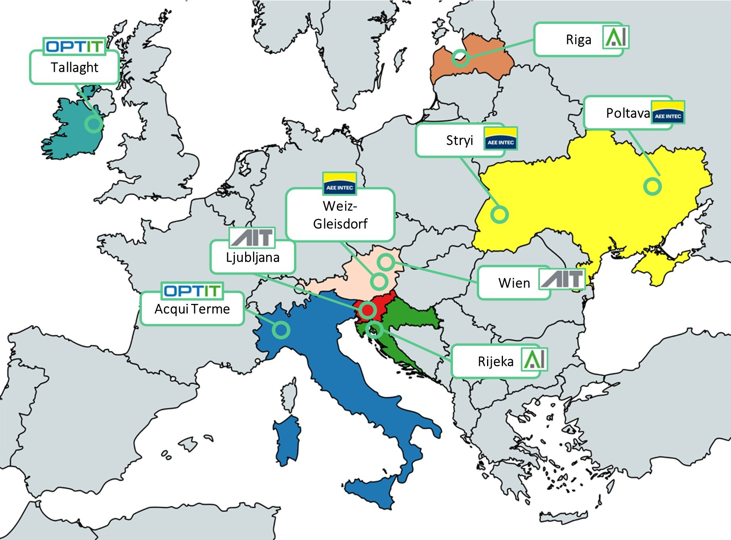

5. ENABLE DHC
Project Overview
Description: EU funded project supporting district heating network operators in the development on their decarbonisation plans and switch to efficient networks as defined in the Energy Efficiency Directive. More info.
Countries: Austria, Belgium, Croatia, Germany, Ireland, Italy, Latvia, Slovenia, Ukraine
Organisations: Coordinator:
Dates: April 2024 – March 2027
12 partner organisations across the 9 participating countries
Approach
The project will develop 9 case studies of investment plans in 7 countries, with a key focus on digitalisation, sector integration and policy development. Analysis of the context and of the reference framework of local heat networks. Interaction and cooperation with relevant stakeholders. Assessment of technical feasibility and overall sustainability of a range of solutions. Development of detailed financial plans and business models. Creation of roadmaps and position papers, handbooks, and capacity building.
Learnings for Heatropolis
The project will include an assessment of options for heat networks to participate in short term electricity markets by providing balancing/flexibility, electricity/gas networks constraints and capacity markets, which would be a valuable learning for Heatropolis. Check on updates and published results in next Horizon Scan.
Outcomes
The project will encourage replication of successful practices through strategic investment planning, stakeholder engagement and dissemination activities.
Relevant themes
Notes:
https://www.envirodual.com/projects/life23-cet-dhc-enabling-strategies-and-investment-plans-for-efficient%2C-multi-energy-and-digitalised-dhc-%E2%80%93-enable-dhc
https://prod.euroheat.org/dhc/eu-projects/enable-dhc

Slide 19
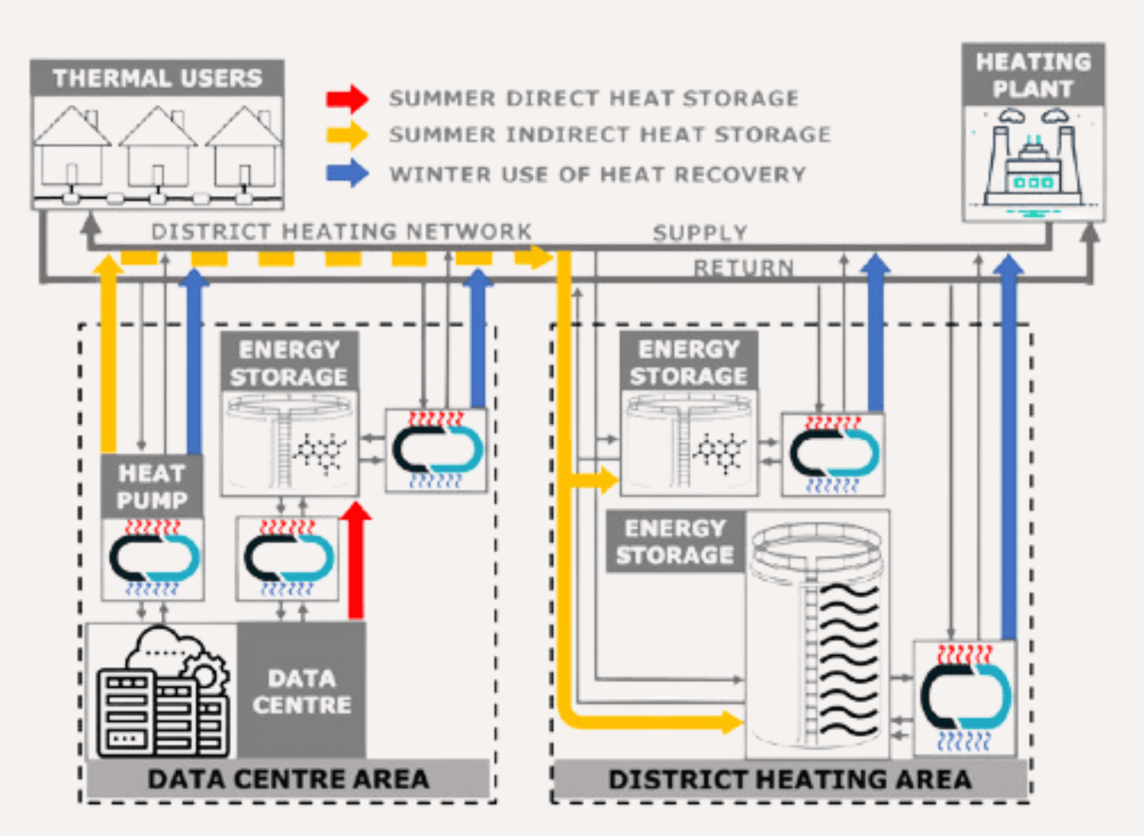



6. Thermochemical storage utilisation enabling data centre seasonal energy recovery (THUNDER)
Project Overview
Description: EU funded project aiming to overcome barriers to adoption of data centre waste heat recovery. The project will develop sustainable strategies and seasonal storage solutions to supply heat to neighbouring heat networks while providing heating/cooling to the data centres. More info.
Countries: Bulgaria, Italy, Belgium, Greece, Spain, Sweden, United Kingdom
Organisations: Coordinator:
Dates: January 2024 – January 2028
13 partner organisations across the 7 participating countries
Approach
This project is targeting the use of thermochemical storage technologies to accumulate heat during summertime and release it into the heat network in the winter period. This storage material have been selected for their compact storage capacity, and near-zero thermal losses. This will be tested in field at the Varna Demo site in Bulgaria. Replicability assessments and pre-feasibility analysis will be developed for 10 further demo sites across Europe. The project will also deliver novel business and financial models.
Outcomes
Expected outcomes include assessment of innovative thermochemical materials for storage applications and advanced control logics for the system optimised controls.
Learnings for Heatropolis
THUNDER will deliver learnings about the use of thermochemical storage for heat networks, as well as seasonal heat flexibility potential. Check on updates and published results in next Horizon Scan.
Relevant themes
Notes:
https://prod.euroheat.org/dhc/eu-projects/thunder-t-hermochemical-storage-utilization-e-nabling-data-centre-seasonal-energy-recovery

Slide 20
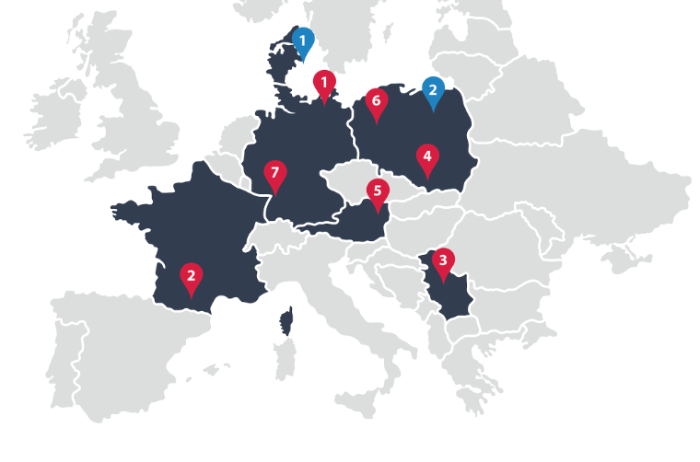
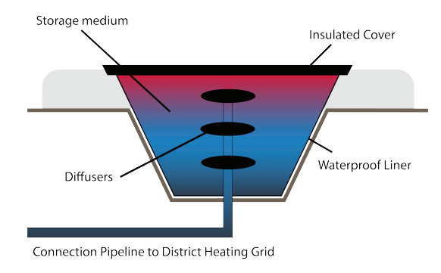

7. TREASURE
Project Overview
Description: EU funded project demonstrating and improving large pit thermal energy storages for an accelerated realisation of sustainable district heating networks in Europe. More info.
Countries: Austria, Belgium, Czechia, Denmark, France, Germany, Poland
Organisations: Coordinator:
Dates: January 2024 – December 2027
22 partner organisations across the participating countries
Approach
Through 7 demonstration projects across 5 countries, this project will refine storage technologies, leveraging data from existing projects in continuous improvement. Establish a benchmark for PTES systems, making them more financially viable, quicker to deploy, energy efficient and supported by a robust expert network. To find possible solutions to the financing, permitting and social challenges in the realisation of large pit thermal energy storage (PTES) projects.
Learnings for Heatropolis
Decarbonised heating systems based on renewable and waste heat sources are challenging due to the intermittency and mismatch of supply and demand. Thermal energy storage is a potential solution to store excess heat during periods of abundance and release it when demand peaks. This project will deliver advancements and learnings on the use of PTES for heat networks. Check on updates and published results in next Horizon Scan.
Outcomes
Deliver 3 operational and monitored large PTES demonstrators and 4 additional demonstrators in an earlier stage of development. Dissemination of developed roadmap and generated knowledge to accelerate the aim of realising over 2000 large PTES crucial for a decarbonised energy system.
Relevant themes
Notes:
https://prod.euroheat.org/dhc/eu-projects/treasure

Slide 21
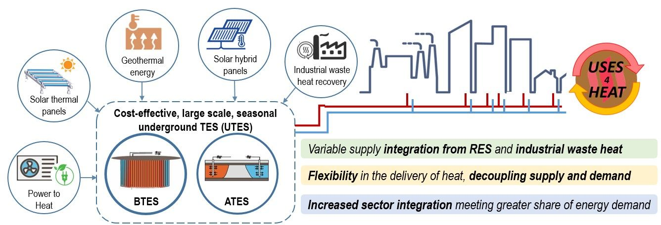

8. USES4HEAT
Project Overview
Description: EU funded project aiming to prove and demonstrate the effectiveness and viability of large-scale, seasonal, underground thermal storage for reliable and decarbonised heat supply. More info.
Countries: Sweden, Italy, Norway, Croatia, Bulgaria, Greece
Organisations: Coordinator:
Dates: December 2023 – December 2027
27 partner organisations across the participating countries
Approach
Implement 2 demonstration sites in Italy and Norway to demonstrate large-scale, seasonal, underground thermal energy storage solutions. 4 replicator sites will learn from the demonstrators and apply the results in their decarbonisation pathways. Develop six key enabling innovative technologies, including drilling solutions, highly efficient solar solutions, and AI driven analytics based predictive energy software. Promote the solutions across the EU and beyond and facilitate market uptake and widespread commercialisation.
Outcomes
Maximise availability and resilience of heat supply while minimising losses and environmental impacts from the heat storage. Demonstrate the storage units as fully integrated into large-scale district heating networks and industrial waste heat recovery.
Learnings for Heatropolis
This project will deliver advancements and learnings on the use of large-scale underground thermal energy storage for heat networks. Check on updates and published results in next Horizon Scan.
Relevant themes
Notes:
https://prod.euroheat.org/dhc/eu-projects/uses-4-heat

Slide 22
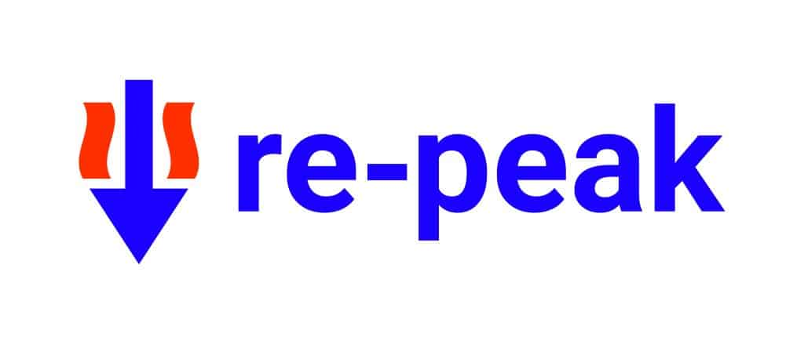



9. RE-PEAK
Project Overview
Description: IEA funded project aiming to better understand the challenge of supplying peak heat loads in a decarbonised heat network and identify carbon-free energy sources suitable for peak heat supply. More info.
Countries: Austria, Belgium, Estonia
Organisations:
Dates: November 2023 – April 2025
Outcomes
The project is expected to deliver recommendations and a self-assessment tool for heat network operators to assess their peak heat decarbonisation options. It will also provide policymakers and branch organisations with an illustrative summary allowing them to directly compare options and their strengths and weaknesses.
Approach
Use modelling to derive a taxonomy of peak heat loads, classified according to criteria such as temperature level, network size and maximum load. Collect empirical data through engagement and surveys with heat network operators to understand their internal definitions of peak heat load and their perceptions on transitioning to climate neutral peak heat supply. Perform a SWOT analysis of various options, particularly “benchmark renewables”.
Learnings for Heatropolis
The results of the research done on heat networks operators direction and attitude to decarbonise heat load will provide useful context for future heat supply technologies and how these could be incorporated into the Heatropolis solution. There may also be useful data on peak loads by type of heat network which could be an input for future iterations of the Heatropolis CBA. Check on updates and published results in next Horizon Scan.
Relevant themes
Notes:
https://energieinstitut-linz.at/en/project/how-to-cover-peak-heat-loads-in-dh-networks-with-renewables/#:~:text=The%20aim%20of%20RE%2DPEAK,tool%20for%20district%20heating%20operators.

Slide 23
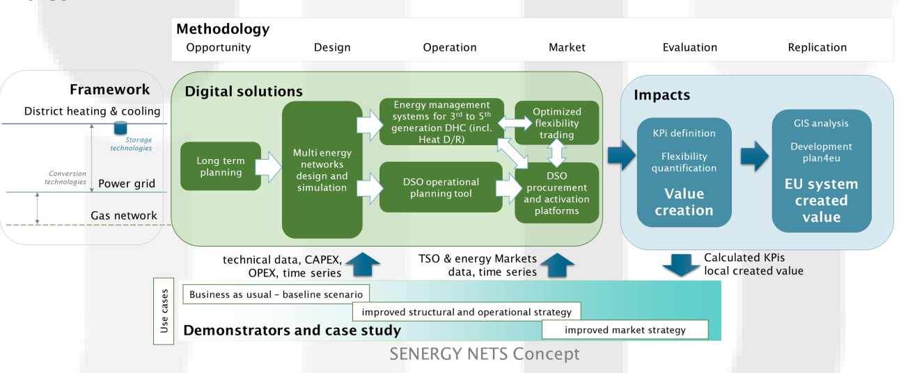

10. SENERGY NETS
Project Overview
Description: EU funded project aimed at increasing the synergy between different energy networks, notably electricity, gas and district heating / cooling networks, while incorporating more locally produced renewable energy. More info.
Countries: Spain, France, Italy, Slovenia, Sweden, Belgium, Austria, Germany
Organisations: Coordinator:
Dates: September 2022 – August 2026
18 partner organisations across the participating countries
Outcomes
The key objectives of the project include: Demonstrate the capability of multi-energy systems to decarbonise the heating and cooling sector using local RES production and sector coupling. Enable multi-energy systems to provide flexibility services by delivering a set of tools for planning and operation. Enabling flexibility provision at local scale by defining market requirements for DSO ancillary services adapted to multi-energy systems.
Approach
Develop a set of tools and platforms (up to TRL7/8) to optimise the planning of district heating and cooling as well as distribution grids with sector coupling consideration and allow the provision of flexibility services to distribution and transmission system operators. These solutions will be implemented on three pilot sites located in Milan, Ljubljana and Paris and their replicability will be tested in two additional real case studies presenting alternative climatic, economic and geographic conditions in Västerås and Cordoba. Develop and apply a consolidated method to evaluate the overall created value by sector integration.
Learnings for Heatropolis
This project is highly relevant to Heatropolis as it is exploring how flexibility and sector integration can enable higher uptake of renewable supplies in heating and cooling networks, while delivering flexibility for the electricity network. The projects should aim to engage and share learnings as part of the WP7 stakeholder engagement plan. Check on updates and published results in next Horizon Scan.
Relevant themes

Slide 24


11. Aberdeen Heat & Power
Project Overview
Description: Aberdeen Heat & Power (AH&P) is an independent, not-for-profit company, founded in 2002 to develop and operate district heating systems. They now operate 4 heat networks across Aberdeen, delivering heat to over 3,000 homes and public buildings. For the moment, they principally use gas fired CHP and have been earning capacity market revenue since 2017. More info.
Countries: Scotland, United Kingdom
Organisations:
Dates: 2017 – present
Outcomes
AH&P CEO Ian Booth stated that “operationally, this has had no effect for us other than business as usual to maintain and maximise operations. The positive financial impact is starting to happen now, and this is expected to increase in subsequent years, which is pleasing to note”. AH&P is looking to expand but securing the funding is a major challenge. They’re planning on exploring a wide range of options to maximise their income, including working with Flexitricity to add more to their revenue stack.
Approach
Working with Flexitricity as aggregator, AH&P started working through the Capacity Market process in 2016. This included ensuring their sites were ready and connected, entering the Early Auctions and T-4 auction, and metering and delivery. As a result, AH&P has been earning Capacity Market revenue since October 2017.
Learnings for Heatropolis
Heatropolis should engage with AH&P to understand in more detail how they are using their assets to participate in the capacity market. There are learnings here about how a natural gas fired CHP heat network is able to participate in flex, and how this could apply to a decarbonised network.
Relevant themes

Slide 25

12. MAGNITUDE (1/2)
Project Overview
Description: EU funded project which aimed to develop business and market mechanisms to provide flexibility to the electricity system by increasing and optimizing synergies between electricity, heat and gas systems. More info.
Countries: France, Austria, UK, Italy, Spain, Belgium, Sweden, Denmark, Germany
Organisations: Coordinator:
Dates: October 2017 – 2020
Outcomes
The project confirmed that MES can definitely provide flexibility to support the integration of renewable energy sources in the electricity system. The simulations carried out for the seven real-life case studies showed that a significant amount of flexibility can be available but only a small part of the available flexibility is actually activated. The project recommended the following policy actions: Aggregation of MES to enable participation to energy markets Harmonisation of EU electricity markets Creation of new frameworks for collaboration between different actors Novel business models can promote energy integration
16 partner organisations across the participating countries
Approach
Used 7 real-life examples of multi-energy systems (MES) to test and validate different regulatory frameworks, sector coupling technologies and business cases. Tested participation in electricity and gas day-ahead markets, Frequency Ancillary Services, Frequency Containment Reserve (FCR), automatic Frequency Restoration Reserve (aFRR) and upward/downward manual Frequency Restoration Reserve (mFRR). Tested improvement strategies such as larger thermal storage, larger gas storage, demand side peak reduction and improved controls. Assessed options against flexibility, energy efficiency, sustainability & economy KPI. Investigated the replicability and transferability of MAGNITUDE's business cases. Developed the specifications and a light implementation of a multi-energy data hub and interoperability layer.
Learnings for Heatropolis
In the Italian case study, site the winter heat peak was able to be reduced by 20% thorough incentivization of heat network end consumers. mFRR was the market with highest profit expectation in 2019, aFRR and FCR are technically feasible but show far lower profit expectation. Revenues from ancillary service markets were not sufficient to recover the additional costs to provide the flexibility for the chosen simulation set-up. Realistic revenues from flexibility exploitation are often overestimated, in particular for the intraday market. Generally, flexibility provision increases energy consumption. Introduction of storage can lead to reduction of wasted energy and therefore overall consumption. Generally, GHG emissions are higher because of the flexibility provision, although installation of local PV generation reduces GHG emissions. More learnings can be found on the project website and final presentation.
Relevant themes

Slide 26
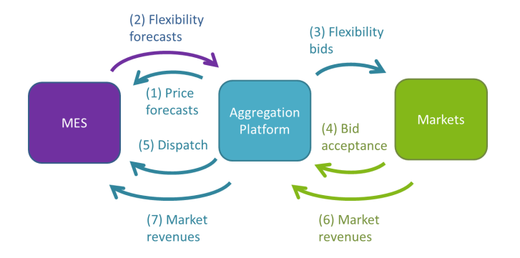
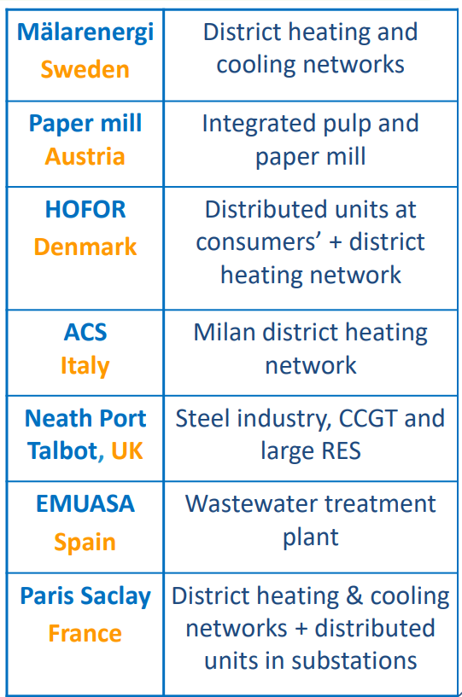
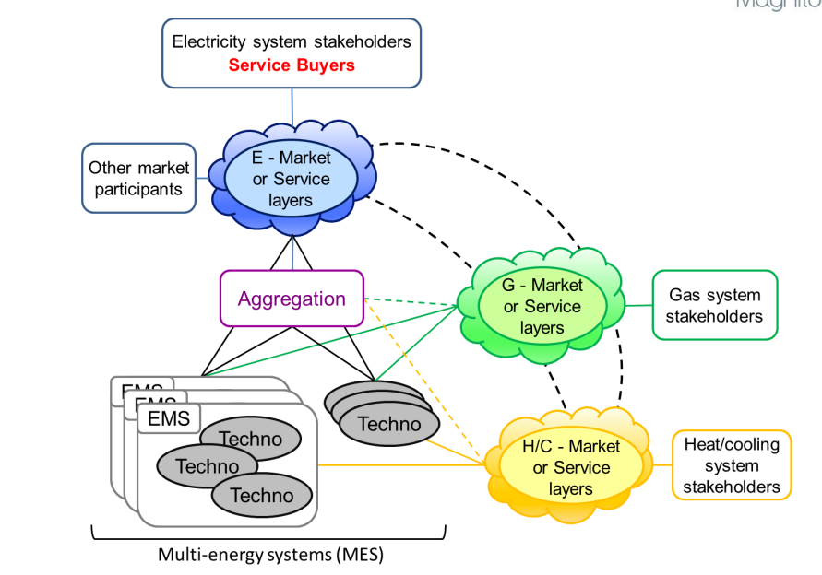
12. MAGNITUDE (2/2)
Basic principles of the interactions between the MES and the aggregation platform
MAGNITUDE overview of case studies
MAGNITUDE overall system architecture
Relevant themes

Slide 27


13. Gateshead District Energy Scheme
Project Overview
Description: Gateshead District Energy is a heat network funded and owned by Gateshead Council, and operated by public limited company, Gateshead Energy Company. Working with Flexitricity, they were the first industrial and commercial customer to enter National Grid’s Balancing Mechanism (BM) in 2018. More info.
Countries: Scotland, United Kingdom
Organisations:
Dates: October 2019 – present
Outcomes
The site was awarded a 15-year Capacity Market contract, at a clearing price of £18/kW in the 2015 T-4 auction. This was brokered through aggregator Flexitricity and pays the Council £60,000 per year. Gateshead Council’s Energy Services Manager, Jim Gill, stated that “The main challenges in the industry are around price volatility so we need ways to make our business plan more resilient and that’s where grid services come in, extra income streams diversifies the way we can generate revenue and that makes our business case much more stable.” Gateshead Council is expanding their heat network and is exploring additional wholesale market trading opportunities. They are also looking at connecting new assets, including a new CHP engine, office buildings and EV charging stations.
Approach
Provides heat and power to customers via a 5km underground network of heat pipes and high voltage “private-wire” electricity cables. Helps to balance the grid through a mixture of 3MWh battery storage, two 2MW CHP engines and a 250,000-litre hot water thermal storage at 30 minutes notice. When demand is high, the CHPs are instructed on by National Grid when they are not already running, and the extra heat generated is put into the network. At times of excess generation, the CHPs are instructed to turn off instead of shutting off wind farms. This can happen for 20 minutes to an hour without affecting heat customers thanks to the network’s thermal inertia and heat storage. The battery has also allowed the scheme to participate in frequency response and triad avoidance.
Learnings for Heatropolis
There are learnings here about how a natural gas fired CHP heat network is able to participate in flex, and how this could apply to a decarbonised network. Flexitricity believe that a heat network with a heat pump could offer the same services to National Grid. Innovation has been critical to the scheme. Specifically, the use of private wires has made the initiative commercially viable. This was achieved through the purchase of high-voltage assets from the DNO to enable the connection of the private wire network to existing buildings.
Relevant themes
Notes:
https://www.gateshead.gov.uk/article/2993/Gateshead-District-Energy-Scheme
https://democracy.gateshead.gov.uk/documents/s28829/GEC%20-%20OSC%20resource%20report%20-%20Jun%202021%20copy.pdf
https://www.gsenetzerohub.org.uk/wp-content/uploads/2020/05/Gateshead-District-Energy-Scheme.pdf

Slide 28
14. IEA Annex 57 (1/2)
Project Overview
Description: Annex 57 (“Flexibility by implementation of heat pumps in multi-vector energy systems and thermal networks”) was a project carried out within the IEA’s Technology Collaboration Programme on Heat Pumping Technologies. It focused on solutions for heat networks and individual heat pumps that can create flexibility for the electrical grid. More info.
Countries: Austria, Denmark, Germany, Netherlands, Sweden
Organisations: Technology Collaboration Programme on Heat Pumping Technologies by IEA
Dates: January 2020 – November 2024
Outcomes
It was shown by various analyses that large heat pumps for district heating have a high economical potential to operate accordingly and act in ancillary services. Some of the cases showed that heat pumps can act in the ancillary service market, especially if they are combined with electrical boilers and weekly storages. But this is a new way to control heat pumps, and there are still barriers to overcome. Several limiting factors to the ramp-up times of large-scale heat pumps were identified including pressure and temperature fluctuations, component stress and wear, heat pump configuration, compressor type and refrigerant type. Barriers to flexibility provision from heat pumps were identified from a technical, regulatory, economic and social perspective.
Approach
Built on Annex 47 which showed that up to 50% of heating demand in Europe could be met by district heating, and 25% of this could be met by heat pumps. Annex 57 focused on the implementation of heat pumps in district heating/cooling systems and the creation of flexibility in the thermal network and electrical grid. Performed energy market analysis of the 5 countries involved. Collected and described 28 real-life cases where heat pumps are integrated and generating flexibility. Detailed descriptions of each example can be found here. Barriers and solutions for individual heat pumps and large-scale heat pumps in district heating networks were identified.
Learnings for Heatropolis
Different types of FCR and aFRR showed the highest cost reduction, while mFRR was slightly less profitable. The combination of a heat pump and an electrical boiler gives certain advantages regarding reaction time and capacity. When it comes to delivering ancillary services, the boiler can react very fast up and down, and it can, thereby, supplement the heat pump to reach the bid limit when the plant operator is putting offers into the market. There are international examples of heat pumps in thermal grids participating in TSOs ancillary markets. One is the CO2 heat pump in Sdr. Felding, which is the first site in Denmark to obtain the official qualification to deliver aFRR regulation. In Denmark this requires a start-up time of max 5 minutes and a min bid size of 1MW.
Relevant themes

Slide 29
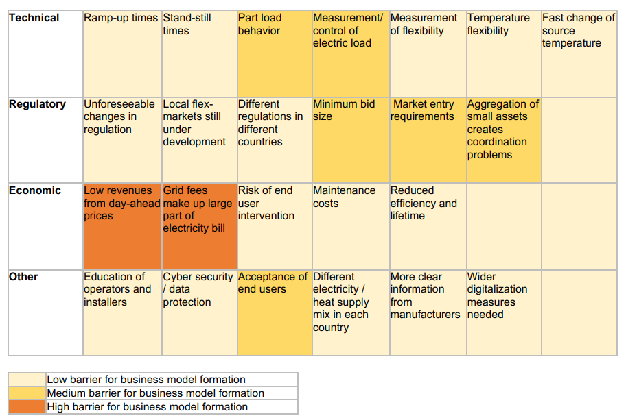
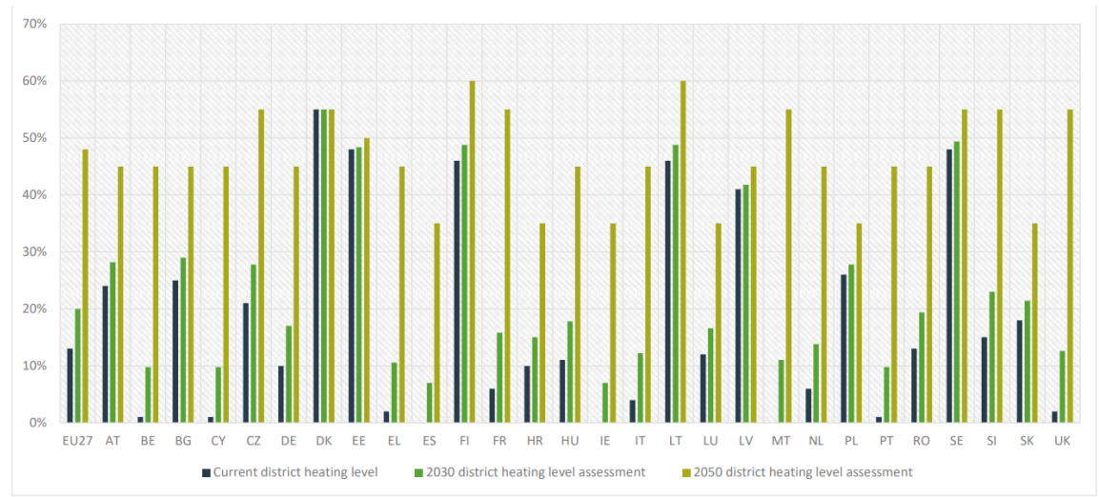
14. IEA Annex 57 (2/2)
District heating levels towards 2030 and 2050 for heating buildings for EU27,
per EU country and UK. (Aalborg university)
Annex 57 Overview of barriers for flexibility business models
Relevant themes

Slide 30

15. Flexi-Sync (1/3)
Project Overview
Description: ERA-Net Smart Energy Systems funded project which aimed to develop, demonstrate and replicate a service to optimise the flexibility from district heating networks and heat customers. More info.
Countries: Austria, Germany, Spain, Sweden
Organisations: Coordinator:
Dates: 2019 – 2022
Outcomes
Production planners used the tool to optimise the production and distribution together with the flexibility in the buildings by sending a control signal from the tool. The production planners logged their experiences with using the tool and validated that it works. All six sites were also evaluated for more extended periods through simulation where the optimal dispatches, with and without the flexibility measures, were compared. Through the integration, a flexibility potential of the flexibility-enabled buildings for the upcoming hours and days has been sent from the NODA system. These forecasts have been utilised in the system optimisation in the Utilifeed platform. The optimised flexibility plan has then been sent back to NODA, which has executed the plan while at the same time guaranteeing the indoor climate in the buildings providing flexibility.
16 partner organisations across the participating countries
Approach
The project developed an optimisation service based on platforms previously developed by Utilifeed and NODA Intelligent Systems. Software for optimising the energy system with an expanded system boundary was developed. It tested the new service in live district heating networks and buildings in the heating season of 2021-2022. There were 6 demonstration sites across the four participating countries. The demonstration work was primarily carried out by Utilifeed and NODA, in close collaboration with the demo site partners. Interactions were set up between the Utilifeed platform and the NODA system, which executed the control in the buildings providing flexibility. The solution used a combination of thermal storage, the thermal inertia of the buildings and heat network and and smart controls to optimise operations.
Learnings for Heatropolis
This project showed that there were no complaints from residents about the thermal comfort of the buildings being used to provide flexibility, providing a positive indication for similar tests in the Heatropolis trials. Results from surveys and workshops done in the project showed that it is essential that occupants understand the flexibility setup but that it is difficult to inform them in an understandable and accessible way. This highlights the importance of educating trial participants as best as we can through WP6. The survey also showed that respondents preferred a flexibility setup in which they have control over the flexibility and are compensated economically for temperature ranges larger than ±0.5°C, over flexibility setups with the same variation and no control or more considerable variations without control.
Relevant themes
Notes:
https://www.ivl.se/english/ivl/press/news/2022-09-15-european-project-shows-how-flexibility-from-the-district-heating-sector-can-add-values-to-the-energy-system.html
https://flexisync.eu/download/18.19b39e311838a550c3c8f82/1665581697317/FlexiSync-Final-report.pdf

Slide 31
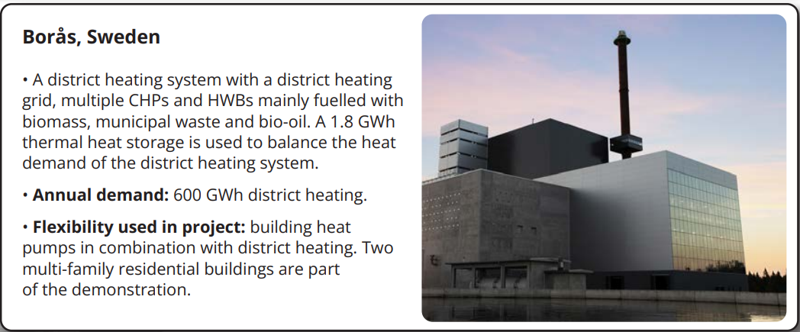
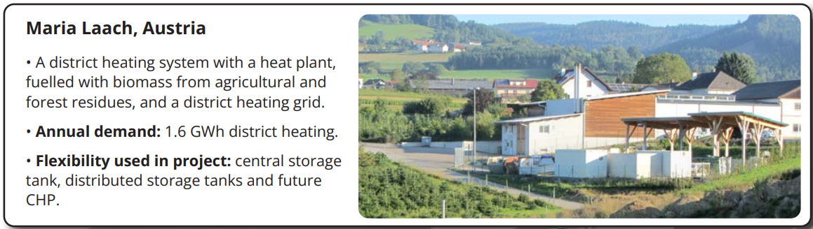
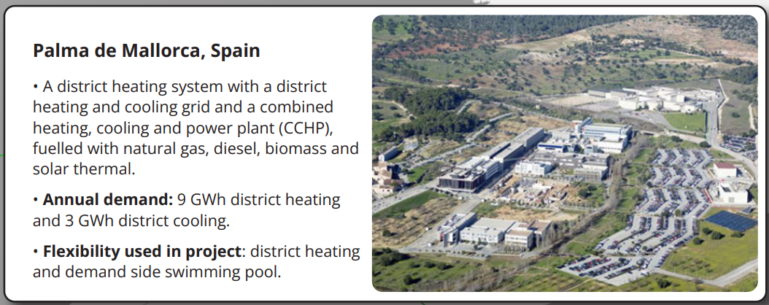
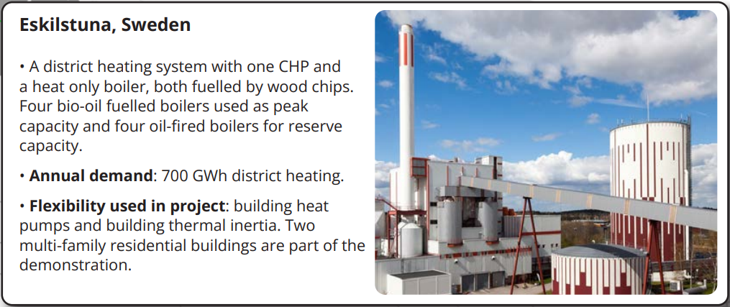
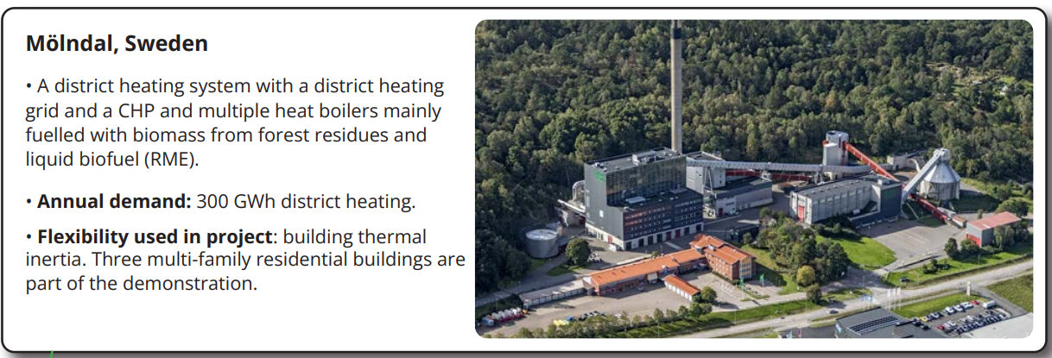
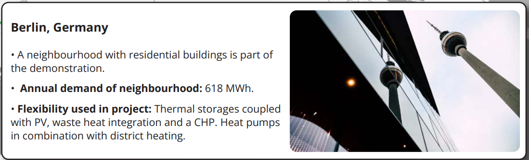
15. Flexi-Sync (2/3)

Slide 32
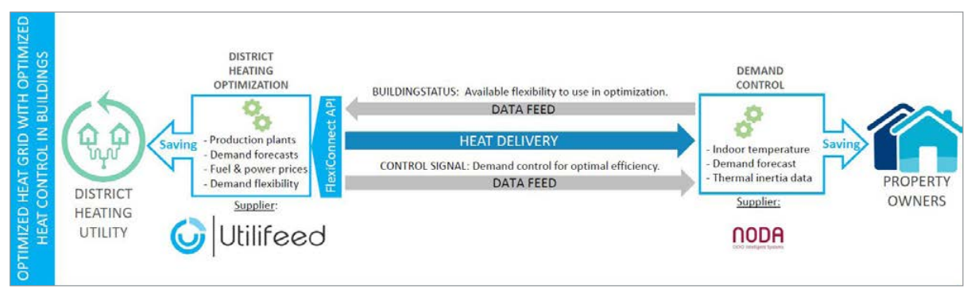
15. Flexi-Sync (3/3)
Diagram showing the solution developed and tested by the Flexi-Sync project
Relevant themes

Slide 33


16. Whole system value of electrified district heating networks in decarbonising heat sector in the UK
Project Overview
Description: Study assessing the whole-system value of using centralised heating technologies to supply a portion of heat demand in the UK in 2035, in contrast to decentralized electrified heat supply. More info.
Countries: United Kingdom
Organisations:
Dates: April 2024
Outcomes
Cost savings in scenarios excluding centralised electric boilers are significantly higher than in corresponding scenarios including these within heat networks. Whole system benefits increase with higher uptake levels of electrified heat networks in supplying electrified heat demand. The inclusion of centralised electric boilers to meet peak demand results in increased reinforcement costs of distribution networks compared to counterfactual scenarios with heat pumps only. This is because their COP is effectively equal to 1, meaning the grid needs to meet a higher peak demand. Increasing the amount of heat network thermal energy storage results in significantly lower peak demand.
Approach
Performed whole system analysis using the Whole-electricity System Investment Model (WeSIM) developed by Imperial College London to evaluate the potential cost savings from rolling out electrical district heating networks to supply some of the UK’s annual heat demand in 2035. Quantified system cost reductions compared to relevant counterfactual scenarios. The model included centralised electric boilers, centralised air source heat pumps and decentralised air source heat pumps, centralised and decentralised thermal energy storage. The model assumed that the electricity sector is decarbonized and 50% of total domestic and commercial heat is supplied by electrified heating technologies.
Learnings for Heatropolis
Quantitative modelling shows that a system-wide rollout of electrified heat networks could result in significant cost savings from a whole-system perspective, highlighting the need and importance of the Heatropolis project. The study demonstrates that rolling out heat networks can result in a reduction in total installed capacity of zero-carbon generation and energy storage. This reduction is significantly higher when centralised electric boilers are excluded as utilising centralised heat pumps with high COPs is more efficient than a mix of heat pumps and electric boilers with low COP. Given that several of the Heatropolis archetypes are planning to use a combination of heat pumps and electric boilers, we should look at the practical implications of this and see if it is possible to use flexibility to reduce the use and reliance on the electric boilers.
Relevant themes

Slide 34

17. EQUINOX (Equitable Novel Flexibility Exchange)
Project Overview
Description: This Ofgem funded project aims to develop novel commercial arrangements and supporting technologies that unlock flexibility from residential low carbon heating (heat pumps), while meeting the needs of all consumers, including the fuel poor and vulnerable. More info.
Countries: United Kingdom
Organisations:
Dates: March 2022 – December 2025
Outcomes
The EQUINOX project has shown that heat pump behavioural change can provide meaningful demand shifting out of the evening peak period. External temperature is a strong driver of demand response​ - slightly more customers chose to opt in on warmer event days, but the average demand response is slightly higher on colder days. Demand response was consistent across commercial arrangements, notice periods and event times​. Automated control of heat pumps is not necessary for the delivery of flexibility.​ Minimal impact on thermal comfort was reported by EQUINOX participants​ with the majority of participants reporting no change or a slight change in comfort.
SP Energy Networks (SPEN), Octopus Energy, PassivUK, Welsh Government, West Midlands Combined Authority, Sero and Guidehouse
Approach
Three trial phases over 3.5 years, building from 365 participants in the first trial to 1,000 in the second trial. The trials are deploying experimental design principles to divide customers into representative groups and test the suitability and effectiveness of different commercial arrangements and processes in unlocking HP flexibility on a large scale. Crossover Randomised Control Trial (RCT) enabled robust statistical analysis. The second trial is testing 3 commercial models to incentivise trial participants to adjust their heat pump settings. It is also testing 3 notice periods (day ahead, morning ahead and 2 hours ahead), 3 event timings and 3 heat pump control methods (manual customer control, remote customer control​ and automated supplier control​).
Learnings for Heatropolis
EQUINOX provides a good example of a project successfully recruiting customers to live trials testing different commercial arrangements and comfort levels. It showed that external temperature is a strong driver of demand response​, something which may therefore also be the case for heat networks. Nearly all trial 2 participants controlled their heat pumps manually or remotely via an app, suggesting that automated control is not necessarily a requirement for active customer participation in flexibility. Check on updates and published results in next Horizon Scan.
Relevant themes

Slide 35
UK Policy & Regulatory Landscape

Slide 36
Current Heat Network Policy & Regulation
Heat Networks (Metering and Billing) Regulations 2014
The purpose of the Regulations is to drive energy efficiency and reduce carbon emissions from heating. This initially came into force in 2014, with further amendments in 2015 and 2020. Part of the Regulations required all heat networks to submit notifications of the heat networks they operate, which led to the creation of the first database of UK heat networks.
The energy efficiency component is driven through the installation of metering devices and billing based on consumption, which aims to decrease the use of energy and result in associated carbon emission savings. Metering also supports fair and transparent billing for customers on heat networks.
The amendments to the Regulations in 2020 introduced building classes that require some heat suppliers with unmetered networks to install metering devices in the buildings they serve.
The Regulations are enforced by the Office for Product Safety and Standards (OPSS) which acts as the Secretary of State for the Department for Energy Security and Net Zero (DESNZ).
The Energy Act 2023
The purpose of this Bill is to make provision about energy production and security and the regulation of the energy market. It sets out ambitious plans to deliver a cleaner, more affordable, and more secure energy system. The Bill covers a wide range of energy topics, including heat networks.
The key point for heat networks is that the Energy Act sets out plans for the regulation of heat networks. It will enable Ofgem to become the regulator for heat networks and give ministers powers to introduce consumer protection rules and emissions limits. As the regulator, Ofgem will be able to investigate if prices appear unfair or too high. It will also introduce a licensing regime allowing heat networks to obtain certain powers like the right to dig up roads.
It also introduces minimum technical standards and decarbonisation requirements, aimed at tackling issues with early heat networks, some of which have been inefficient, built to poor standards, lose a lot of heat and suffer from unplanned interruptions. Additionally, it will enforce heat network zoning which is intended to help accelerate heat network deployment by requiring certain buildings to connect once a zone has been designated.
While this Act was passed in October 2023, its impacts have yet to be fully experienced by heat networks as it has not been fully implemented. Preparations are ongoing, including several consultations which are detailed in slide 39.
Notes:
https://www.gov.uk/guidance/heat-networks
https://www.ofgem.gov.uk/energy-policy-and-regulation/policy-and-regulatory-programmes/heat-networks
https://bills.parliament.uk/bills/3311
https://www.dlapiper.com/en-gb/insights/publications/energy-act/energy-act-2023---is-this-the-silver-bullet-for-the-expansion-of-heat-networks-in-the-uk

Slide 37
Upcoming Heat Network Policy & Regulation
Ofgem Regulation
Ofgem is expected to fully begin regulating heat networks in Great Britain in 2026. Their regulations will focus on customer service, reliability of supply, transparent energy bills and fair pricing.
Some aspects will come into play earlier, such as the launch of consumer advocacy and advice service in April 2025. This will give customers access to free, impartial advice services, as well as the ability to bring complaints to the Energy Ombudsman.
Heat Network Technical Assurance Scheme (HNTAS)
The HNTAS will set out the necessary governance, structures, procedures and standards required to ensure a minimum level of performance and reliability of heat networks. The HNTAS project began in 2022 with DESNZ and its technical partner, Fairheat, developing a technical standards Code. A scheme of assessment and certification has also been developed to ensure heat network compliance with the technical requirements can be demonstrated. Together, these requirements and assurance processes form the Heat Network Technical Assurance Scheme (HNTAS).
The objectives of HNTAS include good consumer outcomes, lower cost of heat, enhanced reliability and service levels, and lower carbon emissions. Core principles of HNTAS are that it will be outcomes orientated, preventative, proportionate, deliverable, adaptable and enforceable.
New networks will need to pass assessment before construction can begin. Existing networks will have a significant transition period to get the right metering in place, to be able to prove performance. Final performance thresholds will be set at a more permissive level for existing networks and these networks will be given time to reach these. HNTAS is due to launch in 2025.
Heat Network Zoning
Heat network zoning will identify zones where heat networks should be the lowest cost solution for decarbonising heat. Specific buildings within those zones will be mandated to connect to a heat network within a prescribed timeframe, which will encourage greater heat network growth and allow economies of scale and critical mass to be realised.
Buildings which will be mandated to connect could include new buildings, large public sector buildings, large non-domestic buildings, and buildings that are already communally heated. There will be exemptions to this, such as where it would not be cost-effective to connect to a heat network or where a better low carbon solution exist.
The methodology to identify potential heat network zones in a consistent manner in towns and cities across the country is still being developed. A new Heat Network Zoning Authority will oversee the implementation of heat network zoning and set national standards, while local Zone Coordinators will be responsible for designating heat networking zones and enforcing requirements.
Notes:
https://www.gov.uk/government/publications/heat-networks-regulation-technical-standards/heat-network-technical-assurance-scheme-hntas
https://assets.publishing.service.gov.uk/media/669fb7b8a3c2a28abb50d545/cibse-2024-huge-changes-to-regulate-uk-heat-networks.pdf
https://www.gov.uk/government/publications/heat-network-zoning-overview/heat-network-zoning-overview

Slide 38
Heat Network Consultations
Multiple consultations have helped to shape the upcoming Heat Network Zoning policy and Ofgem regulation of heat networks, with more to come later this year on the implementation of the HNTAS
Consultation | Description | Dates
Proposals for heat network zoning, link | This consultation sought views on the role of central and local government, zone identification, requirements in zones (consumer protections, emissions, requirements to connect) and zone delivery (selecting developers and ensuring construction). | December 2023 – February 2024
Heat networks regulation: consumer protection, link | This consultation sought views on consumer protection requirements around pricing, quality of service, transparency of information, consumers in vulnerable circumstance, the scope of the rules and how they should be phased in. | August 2023 – October 2023
Heat networks regulation: implementing consumer protections, link | This was the second part to the above consultation and focused on the scope of regulation, how protections will work for non-domestic and small-medium size enterprise consumers, overarching standards of conduct, obligations for fair pricing, protecting vulnerable consumers, step-in proposals and approaches to segmentation. It also sought views on the first draft heat network authorisation conditions and an Impact Assessment setting out the benefits and costs of introducing the consumer protections. | November 2024 – January 2025 Government response not yet published.
Heat networks regulation: authorization and regulatory oversight, link | Run alongside the above consultation, this sought views on Ofgem’s proposals for the monitoring, audit, compliance and enforcement of heat networks. The consultation describes Ofgem’s proposals for implementing the Heat Networks (Market Framework) Regulations 2024, allowing industry to prepare for the implementation of the framework from April 2025, and regulatory rules from January 2026. | November 2024 – January 2025 Ofgem response not yet published.
HNTAS consultation, link | A further heat networks technical standards consultation is planned for 2025, responses to which will need to be taken into consideration for the implementation of the HNTAS scheme and the proposed requirements of the HNTAS Scheme Operator. It will seek views on technical standards for heat networks, including monitoring and compliance for adherence to the standards. | Expected in 2025

Slide 39
Heat Networks Government Funding & Support
Various government funding pots are available for the development and deployment of heat networks, as well as their decarbonisation and efficiency improvements
Scheme | Description | Value | Dates
Heat Network Transformation Programme (HNTP) | The HNTP is the broader government programme providing heat network support through the below schemes, as well as heat training grants, regulation, zoning and broader policy. It also provides resources and tools to assist heat network development. | Not applicable | Ongoing
Heat Networks Delivery Unit (HNDU) | Provides funding and guidance to local authorities and other eligible organisations in England and Wales for heat network project development. It is focused on early-stage development including techno-economic feasibility and detailed project development. | £38 million so far | 2013 – ongoing
Heat Networks Investment Project (HNIP) | Major government scheme to incentive the construction of quality heat network projects through grants and loans and seeking to leverage £1 billion of private sector investment. | £320 million | 2019 – 2022
Green Heat Network Fund (GHNF) | Building on the HNIP, provides funding for the commercialisation and construction of low and zero carbon heat networks. Funding is also available for retrofitting and expansion. The funding has been extended due to the scheme’s success, with £380m+ awarded so far. | £288 million initially | 2022 – ongoing
BEIS Heat Investment Vehicle (BHIVE) | Purchasing system established by DESNZ to enable public sector heat network owners/developers to procure funding for their projects from a range of potential funders. | Not applicable | 2020 – 2025
Energy Bills Discount Scheme (EBDS) | The EBDS support for heat suppliers brings provides support to bring down the price paid for gas and electricity by heat suppliers down to a Minimum Supply Price (MSP). This discount is then passed on to customers and ensure that customers on heat networks do not face disproportionately high heat and hot water bills. | £5.5 billion | 2023 – 2024
Heat Network Efficiency Scheme (HNES) | Funds improvements to existing district or communal heating projects that are operating sub-optimally. | £80 million | 2023 – 2028
Notes:
GHNF:
https://www.businessgreen.com/news/4409758/government-awards-gbp34m-heat-network-funding-projects-leeds-london-kent-devon#:~:text=The%20Department%20for%20Energy%20Security,to%20more%20than%20%C2%A3380m.
EBDS:
https://www.gov.uk/government/news/chancellor-unveils-new-energy-bills-discount-scheme-for-businesses

