Slide 1



Flex Direct
SIF Discovery Phase
End of Phase Meeting

Slide 2
Contents
Project Overview
Project Outputs and Lessons Learned
Project Plan Update
Project Specific Conditions
Plan for Alpha Phase

Slide 3
Project Overview

Slide 4




Context: What is the challenge?
There is a pressing need to enhance energy flexibility usage to meet peak hour energy demands efficiently. Sustain flexibility plays a crucial role in peak demand reduction and helps to defer costly network reinforcement. UK Power Network’s Distribution System Operator(DSO) strategy outlines that their commitment to a “flexibility first” approach to network management will help to reduce £410m of capital investment on the primary and secondary network.
A Need for Energy Flexibility
There is a vast amount of centralised funding available to Local Authorities and Social Housing Providers to undertake energy efficiency retrofits across their region such as the: Home Upgrade Grant and; Social Housing Decarbonisation fund and ECO4 Flex. However, there is no coordination between these social landlords (who represent a large portion of vulnerable customers) and the flexibility supply chain, and what value this could provide both for end-consumers and network constraint management.
Extensive Centralised
Funding for energy efficiency upgrades
This has meant that the present uptake of Sustain flexibility is significantly below par. In the delivery year of 2023/24 55MW of UKPN’s Sustain flexibility demand needs were not met*. Low awareness and commercial appeal of the energy efficiency flexibility product, technical constraints to accurate baselining, and limited safety mechanisms to protect vulnerable customers present major barriers that must be addressed to align the supply chain and unlock wider system benefits.
‘Below Par’ uptake of Sustain Flexibility and barriers
Flex Direct
Solution
Flex Direct aims to develop novel commercial models and coordinated market approaches to enable to direct participation of Local Authorities and Social Housing Providers into flexibility markets, increase the uptake of the Sustain product and facilitate engagement of 'hard-to-reach’ customers at scale.
*Source: UKPN DSO: Distribution Flexibility Services Procurement Report 2023 Appendix A

Slide 5
Flex Direct Project Outcomes
Deliverables
Work Package 1: Establish willingness, capacity and ability for Local Authorities and Social Housing Providers to participate in direct contractual relationships with the DSO through engagement.
Work Package 2: Proposed contractual framework requirements.
Work Package 3: Partnership ecosystem identified with proposed collaboration opportunities, and relative costs & benefits identified for key stakeholders.
Work Package 4: Cost Benefit Analysis of the network at both UK Power Networks and GB level should the Flex Direct approach be scaled.
Benefits
Future reductions in the cost of operating the network, and therefore cost savings per annum on energy bills for consumers.
New processes for organisations to engage with the Flexibility market through the DSO.
Improved access to revenues for Local Authorities and Social Housing providers, therefore contributing to greater social good for vulnerable consumers.

Slide 6
Flex Direct – Mapping Against Other Similar Flexibility SIF Projects
Flex Direct is uniquely focused on assessing the role that Local Authorities can play in providing flexibility response services at scale. We are aware of other innovation projects addressing similar issues and want to maximise knowledge sharing opportunities
CarbonFlex (UK Power Networks)
Dynamically controlling electric heating in low-income households, to provide dynamic flexibility to the grid to manage local grid congestion and respond to grid carbon intensity.
Flex Direct
Focus on 'Sustain' flexibility rather than Dynamic or Secure
Novel commercial models for direct contract from Local Authorities to the Distribution System Operator
Addressing barriers found in Socially Green trial
Broader than only vulnerable customers
Key enabler for “fabric-first approach” and integration of energy efficiency into flexibility markets
Equiflex (Scottish Power Energy Networks)
Barriers to access flexibility markets for all customers
Building on previous work to investigate the opportunities around the electricity Local Area Energy Plans and Local Heat & Energy Efficiency Strategies
KnowMyFlex (UK Power Networks)
Creating Energy Flexibility Certificates to provide a centralised view of a building’s flexibility potential, improving customer and system operator understanding. Similar to Scottish and Southern Electricity Networks’ MaxFlex.
RetroMeter (Electricity North West)
Piloting new ways to accurately evaluate energy savings from energy efficiency measures.
Will feed into any future energy efficiency market mechanism

Slide 7
Project Outputs & Lessons Learned

Slide 8
Work Package 1: Engagement process overview
Longlist of housing providers in licence area (138)
Known contacts shortlisted (16)
Communications materials and interviews designed
Contacts emailed
Additional referrals received (2)
Interviews completed
(8)

Slide 9
Insights from five local authorities and three social housing providers on participating in Flex Direct
Benefits | Barriers
Reduced energy bills for tenants and fuel poverty alleviation Greater energy awareness among tenants Increased tenant appetite for retrofits through providing evidence of reduced consumption Housing providers working towards net zero targets Evidence for future funding by demonstrating effective retrofit measures Consolidated relationship with UK Power Networks Financial reward received can subsidise future retrofit plans | Data protection concerns of monitoring data on tenants’ energy usage Tenant scepticism towards monitoring technology (e.g. smart meters) Resources (time and cost) required to measure demand reduction Retrofit measures that are out of scope for Flex Direct, e.g. electrifying heat and heat networks Risks of not being able to uphold the terms of the contract with UK Power Networks Sitting on the border of the UK Power Networks’ licence area and therefore not all properties qualifying

Slide 10
Key messages
What worked well in the engagement phase?
Well-designed background information materials and comms
Tailored contact with local authorities and social housing providers
Most providers were already implementing energy efficiency retrofits
Providers are open to a variety of funding streams for energy efficiency retrofits, which presents an opportunity to make the case for their monitoring requirements to align with those of Flex Direct
What is needed going forward?
Guidance on terms of the Flex Direct contract, which should avoid penalising providers for failing to reach targets
Clarity on what would constitute effective demand reducing measures that would be suitable for Flex Direct
Information on the level of financial reward available to ensure participation in Flex Direct is worth the investment required to participate (especially in relation to demonstrating reduced demand)
Guidance on best practice for data sharing in relation to demonstrating demand reduction

Slide 11



Work Package 2: Contractual Frameworks
Aim: Establish requirements for contractual frameworks with Local Authorities / Social Housing Providers, including potential length of contracts, establishing baselines for measurement, inclusive models, and technical requirements.
Success criteria: Framework requirements established that have been validated with stakeholders
1. Literature Review
3. Interviews with DSO team
4. Establish Data Requirements and process changes
5. Proof of Concept
6. Milestone complete
2. Benchmark
Evaluated current energy efficiency flexibility products and commercial arrangements, current barriers to uptake and opportunities for Flex Direct
Review and benchmark current processes against new arrangements including tools or levers applied to enable increased uptake energy efficiency flexibility
Interviews with UK Power Networks’ Distribution System Operator to gain understanding on internal and technical barriers and prioritise areas for further investigation.
Establish the data requirements and internal process changes required to implement different options for the commercial arrangements
Integrate relevant amendments following DSO team engagement, assess each option against relevant criteria and develop a proof-of-concept framework
Contractual framework options and requirements established and validated.

Slide 12




Commercial Arrangement Options for Flex Direct
We have considered several different options for the novel commercial models and contractual frameworks to enable the direct provision of ‘sustain’ flexibility by Local Authorities and Social Housing Providers through energy efficiency upgrades.
Literature Review Findings:
Key Barriers to Uptake
Possible Tools / Components
Commercial Arrangement Options
Low awareness
Targeted marketing in Constraint Management Zones
1
Enhanced Business As Usual Scenario
Limited commercial appeal
Longer Contract lengths
FA
Baselining challenges
Alternative Baselining Approaches
DSO
2
Increasing level of change to current system
Direct Contracting with Local Authorities
No alignment with existing funding
Alignment with central energy efficiency funding
LA
Neglected preventative network planning
Procurement Outside of Constraint Management Zones
DSO
Lack of Incentives
DNO Capital Incentives
Ofgem Capital Incentives
3
Direct Contracting with Local Authorities, and wider supply chain
LA
Lack of whole systems planning
Centralised Flexibility Procurement
DSO
SHP
EMC

Slide 13

Commercial arrangement options for Flex Direct
In Discovery, we have shortlisted three commercial arrangement options, each with varying stakeholder roles, responsibility and risk, to be explored for Alpha.
1. Enhanced business as usual Scenario
2. Direct contracting with local authorities
3. Direct contracting with local authorities, and wider supply chain
LA
FA
LA
LA
EMC
DSO
DSO
DSO
SHP
Minor adjustments to current Sustain flexibility process to encourage further participation from Local Authorities and Social Housing Providers.
Flexibility Aggregator is key party responsible
Activities include: increased marketing, longer contracts, alternative baseline approaches and amended competition timelines.
Direct procurement from Local Authorities, adapting processes to engage more participants driven by service improvement
Local Authority is key party responsible
Activities include: (addition to Option 1 activities) in-depth support and engagement with LAs to upskill and determine incentive levels, contractual clauses amendments regarding under-utilisation.
Direct procurement with private stakeholder support, emphasizing commercial viability and scalability through increased costs and expertise.
Activities include: (addition to Option 1 activities) some upskilling support, reviewing of service fees, contractual clauses amendments regarding under-utilisation, sub-contracting and governance
Score
Score
Score
Alignment to DSO / RIIO- ED2 requirements:
Alignment to DSO / RIIO- ED2 requirements:
High
Alignment to DSO / RIIO- ED2 requirements:
High
High
Impact (benefit and scalability):
Medium
Impact (benefit and scalability):
High
Impact (benefit and scalability):
High
Complexity to Deliver (time and cost):
Medium
Complexity to Deliver (time and cost):
Medium
Complexity to Deliver (time and cost):
Medium
Risk (to delivery and competition):
Low
Risk (to delivery and competition):
Medium
Risk (to delivery and competition):
Medium

Slide 14


Work Package 3: Partnership Ecosystem- Approach
Aim: Create a partnership ecosystem to align various stakeholders across the energy efficiency and flexibility value chain. This will seek opportunities for collaboration to address the problem, from a community of partners, with the aim of delivering improved outcomes by working together.
Success criteria: Mapping of stakeholders and design of partner ecosystem for further engagement in Alpha Phase
1. Desktop Research
2. Vision Statement
3. Stakeholder
Mapping
4. Determine needs and motivations
5. Categorise Stakeholders
6. Milestone complete
Undertake desktop research on available energy efficiency funding sources for Local Authorities and Social Housing Providers (including size, specifications and funding timelines) across UK Power Networks’ area
Develop a vision statement
“To create a partnership ecosystem that aligns relevant stakeholders across the energy efficiency and flexibility value chain to deliver improved outcomes for the network, supply chain and end-consumers”
Map all stakeholders
that could come together to solve this problem, including
Funding partners
Delivery partners
Data partners
Education partners
Define drivers, opportunities and responsibilities
for each stakeholder group to be considered within the Partnership Ecosystem for Flex Direct.
Categorise the stakeholders
into tiers to determine who would be most relevant to participate in Flex Direct and why
Complete a proof of concept for each partner in the ecosystem to be explored in Alpha and how to address current limitations

Slide 15























Work Package 3: Stakeholder Mapping
Key stakeholders across the energy efficiency and flexibility were mapped to determine whose business needs and likely level of influence could lead to favourable outcomes for Flex Direct
Local authorities and social housing providers
Key Questions to consider
Energy Management Companies
DSOs
Which stakeholders’ own business needs align most strongly with Sustain (from Energy Efficiency) to increase the likelihood of favourable outcomes for the network and end-consumers?
Flexibility providers/
aggregators
Trade associations and industry groups
Utilities and energy suppliers
NGOs and advocacy groups
Which stakeholders are key decision makers within the energy efficiency and flexibility supply chain who could readily mobilise solutions that will target the increased provision of energy efficiency flexibility?
Research Institutions & Think Tanks
Government Agencies & Regulatory Bodies
Which stakeholders are likely to bring a greater level of impact, and lower level of risk to this initiative?
Energy efficiency service providers
Community Energy Groups
KEY
Financial institution and investors
Manufacturers and suppliers of energy-efficient technologies
Tier 1: Tier 2: Tier 3:

Slide 16
Work Package 3: Stakeholder Prioritisation
Stakeholders were categorised based on their influence, strategic significance and impact on energy efficiency and flexibility markets to help focus efforts during further engagement in Alpha
Tier 1: Direct involvement
Organisations that will have a primary role in increasing the uptake of energy efficiency flexibility due to their business needs, level of interest and strategic significance.
Likely to be directly involved in the delivery of new commercial arrangements and will be prioritised for further engagement and participation during Alpha. Further details on the stakeholders outlined in this tier are covered on the next slide.
Example: DSOs, Local Authorities, Social Housing Providers, Energy Management Companies, Flexibility Providers
1
Tier 2: Wider Enablers
Stakeholders with some interests and business needs that align with the key objectives of Flex Direct, but are likely to have limited impact or influence, and may therefore play an indirect role in increasing energy efficiency flexibility.
Stakeholders in this tier will be engaged with at a high-level during the Alpha Phase.
Example: Government Agencies and Regulatory Bodies, Energy Efficiency Service Providers, Energy Suppliers
2
Tier 3: Third Party Support
Third party organisations that are likely to have a limited influence or impact in increasing the uptake of energy efficiency flexibility and will therefore be involved in Flex Direct in a relatively restricted capacity.
Example: Community Energy Groups, Research Institutions and Think Tanks, Manufacturers of Energy Efficiency Technologies, Financial Institutions, Trade Associations and Non-Governmental Organisations
3

Slide 17
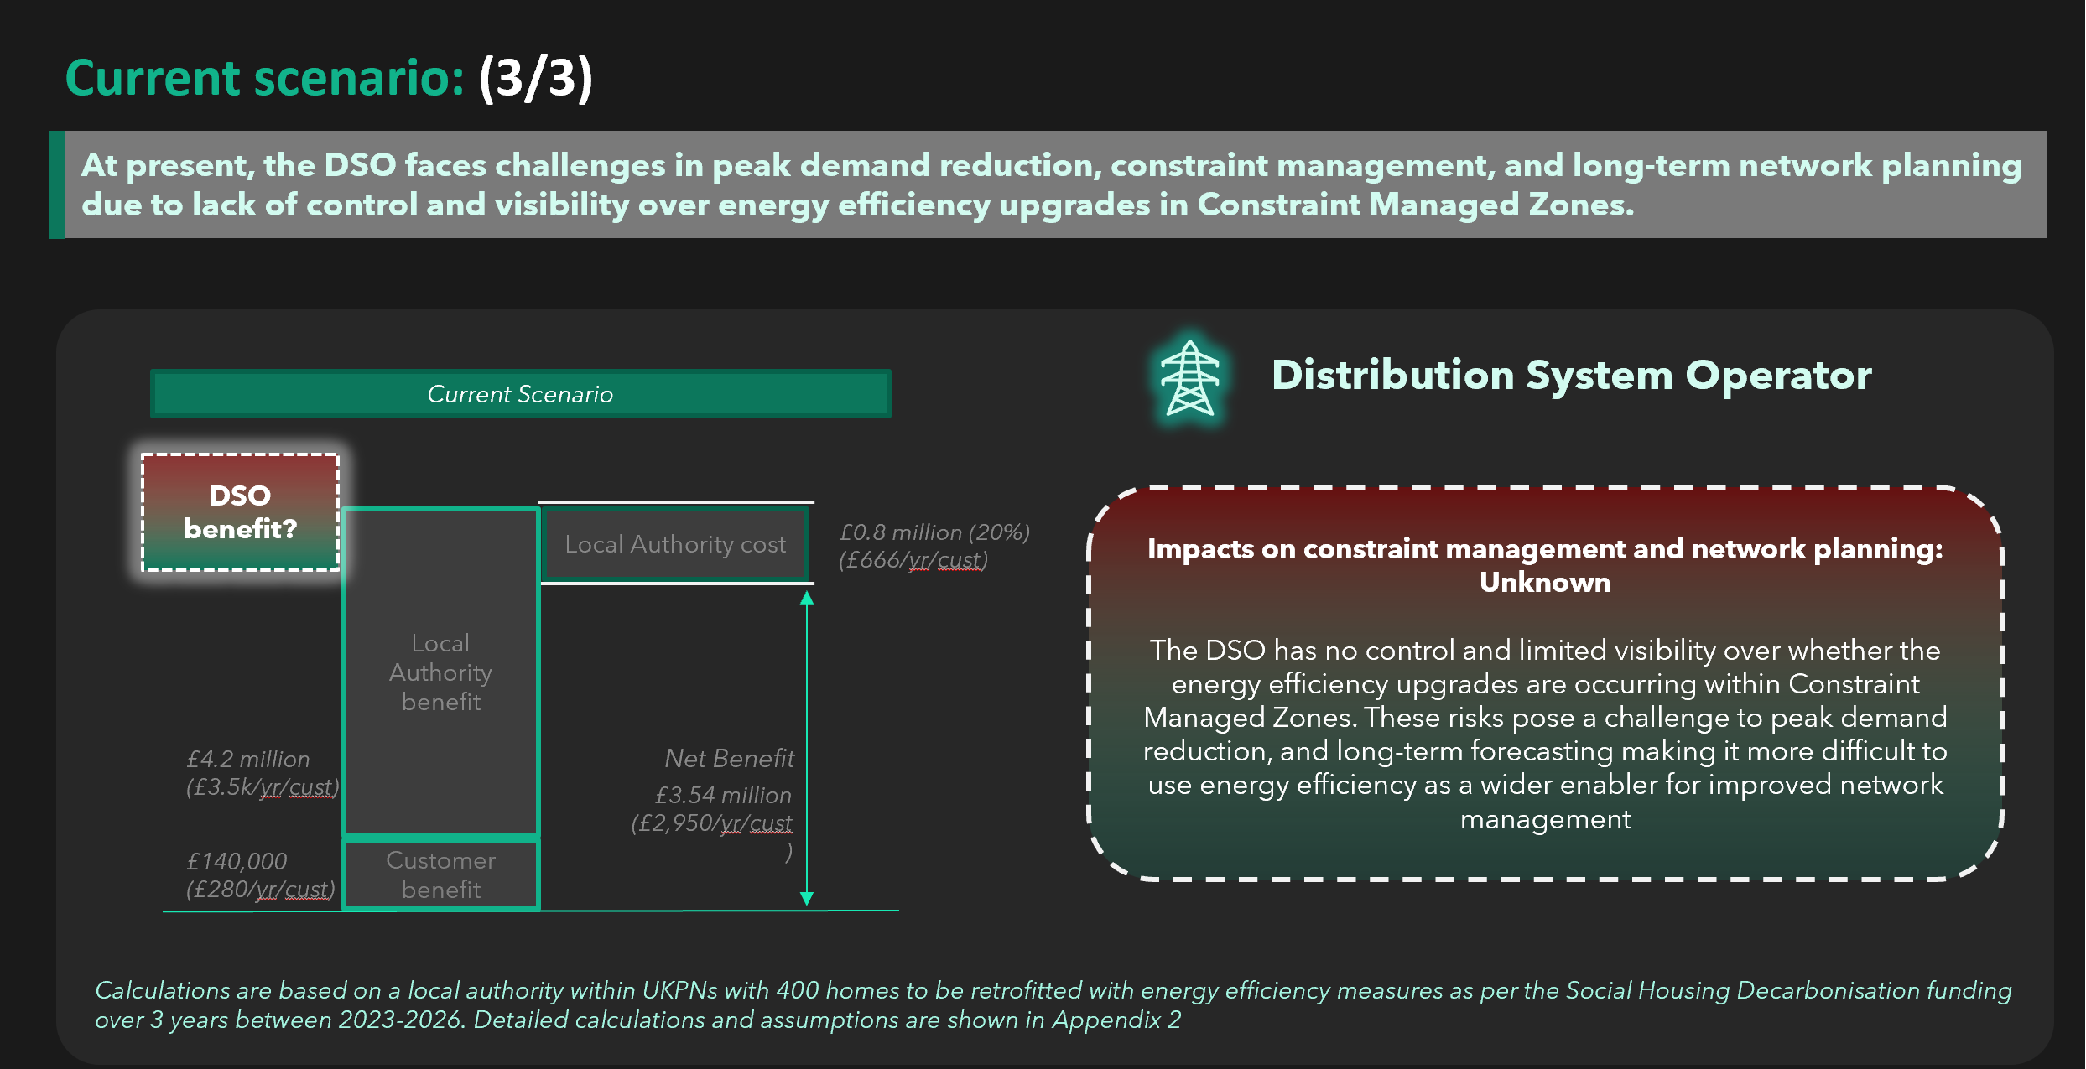

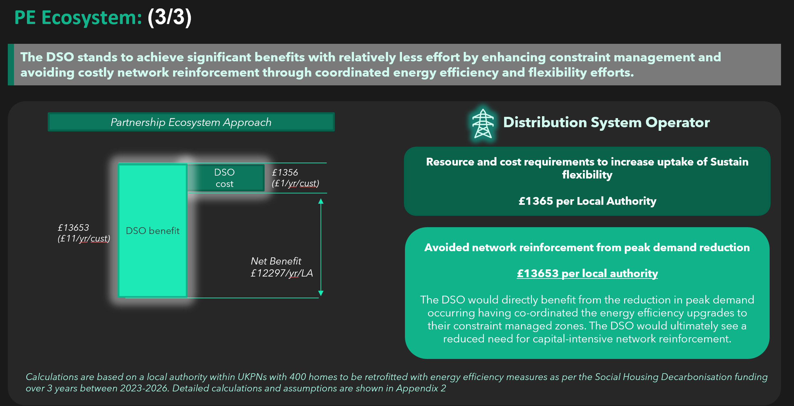
Work Package 3: Value Analysis
We conducted an analysis to show Tier 1 stakeholders the potential benefits of integrating energy efficiency and flexibility within a Partnership Ecosystem, compared to the current scenario, where these aspects are not considered together.
1
Tier 1: Direct involvement
Organisations that will have a primary role in increasing the uptake of energy efficiency flexibility due to their business needs, level of interest and strategic significance.
Likely to be directly involved in the delivery of new commercial arrangements and will be prioritised for further engagement and participation during Alpha. Further details on the stakeholders outlined in this tier are covered on the next slide.
Example: DSOs, Local Authorities, Social Housing Providers, Energy Management Companies, Flexibility Providers
2
3
Value Analysis:
We considered the example of a local authority within UKPN’s network area, who has received funding from the Social Housing Decarbonisation Fund to undertake energy efficiency retrofits across 400 homes between 2023 and 2026.
To estimate the added value that a Partnership Ecosystem could unlock for each key stakeholder, we reviewed factors such as:
Administration and Ancillary costs associated with bid writing and governance for a Local Authority
Total funding received from a centrally funded energy retrofit scheme to complete retrofits
DSO resource cost to procure additional energy efficiency flexibility
Added revenue generated for the Local Authority by providing flexibility services to the DSO
Added value within a Partnership Ecosystem

Slide 18


Work Package 3: Roles and Responsibilities for Tier 1 Stakeholders
Identified the roles of the most critical stakeholders that could come work together to define an impactful partnership ecosystem for energy efficiency flexibility
Distribution System Operators
Local Authorities/Social Housing Providers
Energy
Management Companies
Establish resource requirements, and minimum acceptable incentive levels to participate in energy efficiency flexibility
Aggregate relevant properties under their management portfolio to meet flexibility requirements
Use existing funding for efficiency upgrades to either:
Operate independently as flexibility service providers and provide sustain flexibility directly to the DSO
Or work closely with a Flexibility Aggregator to do the same
Delivering energy efficiency retrofits
Undertaking baselining of historical consumption and be able to accurately calculate the aggregated volumes of sustain flexibility that may be provided to the DSO
Provide an end-to-end platform that includes asset monitoring, control and virtual power plants to readily provide increased volumes of sustain flexibility to the DSO
Establish resource requirements, and minimum acceptable incentive levels to participate in energy efficiency flexibility
Flexibility Aggregators
Accurately establish and communicate network constraint needs to supply chain
Consulting with other Tier 1 stakeholders to understand their needs
Provide knowledge sharing and upskilling to allow new market entrants to provide sustain flexibility from energy efficiency
Defining of roles across the procurement supply chain
Changing procurement processes, timelines, contractual changes
Reviewing utilisation fees offered to new possible market entrant
Continue to take primary role in the provision of Sustain flexibility to the DSO
Provide upskilling / knowledge share to the wider group of Tier 1 stakeholders to inform the Local Authorities / Social Housing Providers who wish to take on this role (less likely)
Establish resource requirements, and minimum acceptable incentive levels to participate in energy efficiency flexibility
Tier 2 and 3 organisations will have a role in enabling the wider supply chain to uptake energy efficiency flexibility and unlocking added benefits, and will also be engaged with during future phases of this project

Slide 19
Key Takeaways
Unlikely organic growth
Energy efficiency flexibility in its current form is unlikely to lead to organic uptake, by the market, due to limited awareness, insufficient incentive levels and a lack of co-ordination between key stakeholders across the supply chain.
The importance of local authorities
In the Flex Direct Partnership Ecosystem, Local Authorities (with or without Flexibility Aggregators) will play a crucial role in delivering energy efficiency flexibility, by leveraging substantial government subsidies for retrofits. Findings from Work Package 1 and 2 indicate Local Authorities’ clear interest in participation but highlight the need to reassess current commercial arrangements to address concerns and enhance commercial viability.
Presently unfeasible arrangements
Considering present Sustain service fees and contract durations, the resourcing costs required for a Local Authority, a relatively inexperienced new market entrant, presently outweigh the revenue earnt by meeting the contract terms and providing agreed volumes of peak demand reduction to the DSO directly.
DSO to take the lead
If current commercial arrangements for energy efficiency sustain flexibility remain unchanged, the DSO would need to take the lead, providing knowledge sharing and upskilling support to supply chain stakeholders to enable direct participation in flexibility markets.

Slide 20
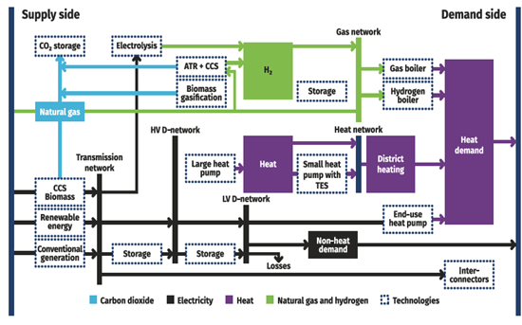
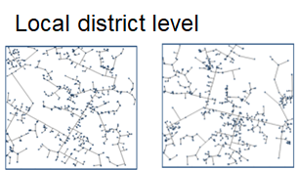
Work Package 4: Assess the benefits of scaling up Flex Direct
Producing a Cost Benefit Analysis (CBA) considering potential network, consumer, and environmental benefits of scaling the Flex Direct approach across UK Power Networks and Great Britain
IWES – Integrated Whole-Energy System model
Identify and quantify the whole energy system benefits of social houses’ energy efficiency improvement and participation in flexibility services using IWES
Future Energy Scenario

Slide 21
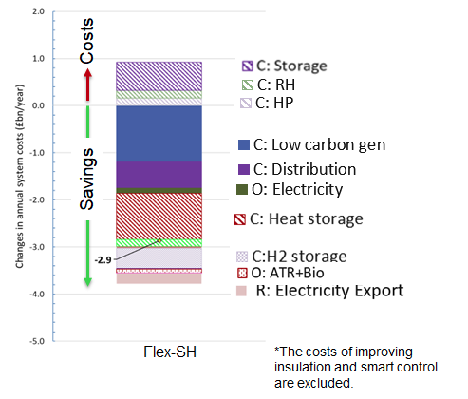
Work Package 4: Assess the benefits of scaling up Flex Direct
Potential savings that can be harnessed through Flex Direct
Load-Related Expenditure (LRE) and Cost-Benefit Analyses using the Ofgem template
Region | 10-year NPV (£m)
UK Power Networks | 110
Great Britain DNOs | 315
Savings in low-carbon generation investment, distribution network reinforcement cost, electricity operational expenditure, heat storage, and other flexibility technologies .

Slide 22
Peak Demand Reduction (LRE input)
Sources: England, Welsh and Scottish governments: social housing stock, and LSOA/DZ and local authority lookup
Office for National Statistics and Scottish Government: OA, LSOA, and DZ boundary map
The NG ESO: GIS boundaries for GB DNO licence regions
Assumptions
Resistive heating replaced with heat pumps
Three-year network planning horizon
All social hosing providers participate in Flex Direct
Constant efficiency implementation over years
All social houses are EPC-C by 2028
Rightmove’s energy bill tracker (used as a proxy for peak reduction)
Social housing stock per local authority area
DNO regions
Average peak reduction is about 32%
Social housing stock per DNO area
Percentage of social homes per EPC rating
Percentage of social homes rated EPC D-F is 44%
Peak demand reduction per DNO area
Network planning
Average ADMD is 2.82 kW
Time horizon for implementing peak reduction in network planning
Counterfactual: three years
Flex Direct: immediately
Typical after diversity maximum demand (ADMD)

Slide 23
Load Related Expenditure Results
These modelling results demonstrate the potential benefits that Flex Direct could bring to the electricity networks should it be implemented as soon as 2025. Further in-depth modelling and subsequent trials will be required to validate these results.
UK Power Networks’ Network
All GB DNO Networks
FlexDirect defers distribution network reinforcement to later years
FlexDirect has indirect carbon benefits as it defers network reinforcement.

Slide 24
Project Plan Update

Slide 25
Project Plan - Planned
 |  | March |  |  |  |  |  |  |  |  |  |  |  |  |  |  |  |  |  |  |  |  | April |  |  |  |  |  |  |  |  |  |  |  |  |  |  |  |  |  |  |  |  |  | May
 |  | ## | 4 Mar 2024 |  |  |  |  | 11 Mar 2024 |  |  |  |  | 18 Mar 2024 |  |  |  |  | 25 Mar 2024 |  |  |  |  | 1 Apr 2024 |  |  |  |  | 8 Apr 2024 |  |  |  |  | 15 Apr 2024 |  |  |  |  | 22 Apr 2024 |  |  |  |  | 29 Apr 2024 |  |  |  |  | 6 May 2024 |  |  |  |  | 13 May 2024 |  |  |  |  | 20 May 2024 |  |  |  |  | 27 May 2024
 | Work Package (WP) and task description
WP1 | Engagement with local authorities and social housing providers
1.1 | Establish the precursors (capacity and opportunity) to engagement.
1.2 | Develop and prioritise contacts list for targetted engagement.
1.3 | Develop and pilot capacity building tools and process by working with LA or SHP champions
1.4 | Compile and analyse results into an intermediate report
WP2 | Establish requirements for contractual framework
2.1 | Literature review of current energy efficiency flexibility producsts and commercial frameworks
2.2 | Workshops with UKPN flex & data teams to gain understanding on commercial and technical/data and document barriers and prioritise opporunities for investegation
2.3 | Establish and design data requirements and internal process mapping
2.4 | Develop a proof of concept framework for direct contracting with the DSO.
WP3 | Develop partnership ecosystem framework
3.1 | Undertake desktop research on available energy efficiency funding sources for LAs & SHPs
3.2 | Design a partnership ecosystem framework across the Energy Efficiency Flexibility Value Chain
WP4 | Assess the benefits and opportunity to scale
4.1 | Estimate the volume of additional flexibility that can be achieved by Flex-Direct approach
4.2 | Simulate the future GB energy system with and without Flex-Direct solution
4.3 | Evaluate the whole-system gross benefits of the Flex-Direct solutions
4.4 | Analyse the implications to the system capacity and other flexibility requirements.
WP5 | Project Management
5.1 | Plan (identify and agree on key milestones under each workstream, risks, dependencies, and review process)
5.3 | Monitor progress and learning with fortnightly team meetings, Show & Tell webinar and end of phase meeting
5.4 | Produce end of phase reporting

Slide 26
Project Plan - Actual
 |  | March |  |  |  |  |  |  |  |  |  |  |  |  |  |  |  |  |  |  |  |  | April |  |  |  |  |  |  |  |  |  |  |  |  |  |  |  |  |  |  |  |  |  | May
 |  | ## | 4 Mar 2024 |  |  |  |  | 11 Mar 2024 |  |  |  |  | 18 Mar 2024 |  |  |  |  | 25 Mar 2024 |  |  |  |  | 1 Apr 2024 |  |  |  |  | 8 Apr 2024 |  |  |  |  | 15 Apr 2024 |  |  |  |  | 22 Apr 2024 |  |  |  |  | 29 Apr 2024 |  |  |  |  | 6 May 2024 |  |  |  |  | 13 May 2024 |  |  |  |  | 20 May 2024 |  |  |  |  | 27 May 2024
 | Work Package (WP) and task description
WP1 | Engagement with local authorities and social housing providers
1.1 | Establish the precursors (capacity and opportunity) to engagement.
1.2 | Develop and prioritise contacts list for targetted engagement.
1.3 | Develop and pilot capacity building tools and process by working with LA or SHP champions
1.4 | Compile and analyse results into an intermediate report
WP2 | Establish requirements for contractual framework
2.1 | Literature review of current energy efficiency flexibility producsts and commercial frameworks
2.2 | Workshops with UKPN flex & data teams to gain understanding on commercial and technical/data and document barriers and prioritise opporunities for investegation
2.3 | Establish and design data requirements and internal process mapping
2.4 | Develop a proof of concept framework for direct contracting with the DSO.
WP3 | Develop partnership ecosystem framework
3.1 | Undertake desktop research on available energy efficiency funding sources for LAs & SHPs
3.2 | Design a partnership ecosystem framework across the Energy Efficiency Flexibility Value Chain
WP4 | Assess the benefits and opportunity to scale
4.1 | Estimate the volume of additional flexibility that can be achieved by Flex-Direct approach
4.2 | Simulate the future GB energy system with and without Flex-Direct solution
4.3 | Evaluate the whole-system gross benefits of the Flex-Direct solutions
4.4 | Analyse the implications to the system capacity and other flexibility requirements.
WP5 | Project Management
5.1 | Plan (identify and agree on key milestones under each workstream, risks, dependencies, and review process)
5.3 | Monitor progress and learning with fortnightly team meetings, Show & Tell webinar and end of phase meeting
5.4 | Produce end of phase reporting

Slide 27
Progress to Plan - Summary
Delivery of all work packages are on track to be completed by the end of May.
Partner | Work Package | Deliverable | Progress
Centre for Sustainable Energy | 1: Engagement with Local Authorities & Social Housing Providers | Report on insights gathered from Local Authorities & Social Housing Providers, to establish willingness, capacity and ability to participate in direct contractual relationship with the DSO to deliver flexibility | First draft delivered
Sia Partners | 2: Establish framework requirements | Report compiling proposals and establishing requirements for contractual frameworks with LAs/SHPs. | First draft delivered
Sia Partners | 3: Develop partnership framework | Report compiling proposals and defining a partnership ecosystem to align various stakeholders across the energy efficiency and flexibility value chain. Additional: identifying LAs that are more or less likely to be engaged on flexibility due to financial status and resources. | First draft delivered
Imperial College Consultants | 4: Cost Benefit Analysis of scaling | Produce CBA considering potential network, consumer and environmental benefits of scaling the Flex Direct approach across UKPN’s network area and GB. | First draft delivered

Slide 28
Progress to Plan
Deliverables | Outcome
Finances | On target
Risk management | On target
Project communications | On target
Project specific conditions | Complete
Show and tell | Session booked, preparations underway

Slide 29
Risks
Ref | Risk Description | Likelihood (Low/Medium/High) | Impact (Low/Medium/High) | Outcome | Status
R1 | Staff being unavailable due to sickness, absence etc | Low | High | There were no significant absences Annual leave and bank holidays were proactively managed | Closed
R2 | Availability of Local Authorities, Social Housing Providers and Community Energy Groups for engagement | Medium | High | Partners collaborated to reach out to a wide number of organisations, to ensure enough stakeholders were engaged with to provide significant feedback Engagement sessions were efficiently planned to make the most of the time available | Closed
R3 | Availability of data for CBA modelling | Medium | Medium | Partners shared insight and undertook further research to help shape the CBA modelling and identify trusted publicly available data sources where partner-owned data was not enough. | Closed

Slide 30
Lessons Learnt
Visibility and engagement with other partners work packages can aid deeper understanding of interconnectivity of work packages across the project
Testing assumptions with other partners can help to effectively shape deliverables
Having a firm understanding of factual vs counterfactual (i.e. in this case, a world with or without the Flex Direct proposal) can help to focus the understanding of benefits and impact

Slide 31
Project Specific Conditions

Slide 32
Project Specific Conditions
Condition | Description | Update
1 | The Funding Party must not spend any SIF Funding until contracts are signed with the Project Partners. | Complete
2 | The Funding Party must report on the financial contributions made to the Project as set out in its Application. Any financial contributions made over and above that stated in its Application should also be reported and included within the Project costs template. | On track
3 | The Funding Party must participate in all meetings related to the Project that they are invited to by Ofgem, UKRI and BEIS during the Project Phase. | On track

Slide 33
Project Specific Conditions
Condition | Description | Update
4 | Prior to the completion of the Discovery Phase the Funding Party must present an updated Project plan to the Monitoring Officer assessing impacts on housing tenants, networks and markets. | Project plan updated to include: WP1: Considering impact on housing tenants WP2 & WP3: Considering impact on networks and markets WP4: Considering impact on GB networks Updated project plan will be shared as evidence.
5 | Prior to the completion of the Discovery Phase the Funding Party must provide evidence to the Monitoring Officer to show linkages and to understand the duplication risk or knowledge sharing opportunity of the scope of this Project against Discovery Round 3 Projects – EquiFlex and CarbonFlex. | Project managers of Flex Direct, Equiflex & CarbonFlex met to identify linkages, clarify different aims of projects and identify knowledge sharing opportunities. Document provided to evidence this.

Slide 34
Next Steps

Slide 35
Next Steps
The current Sustain* flexibility product is not seeing high uptake of energy efficiency measure use cases. The potential benefits of large-scale energy efficiency measures resulting in large-scale measurable avoided network reinforcement remains an untapped space. There will be value in UK Power Networks developing a large-scale trial to assess the potential whole-system benefits.
If a large-scale Sustain energy efficiency trial is successful for both DSO and the housing provider, this can help to stimulate market-awareness as well as provide clarity on appropriate contractual duration and payment reward regimes.
1
Identify Flexibility Zones with multi-year flexibility requirements which may be appropriate for Sustain delivered from large-scale energy efficiency measures
2
Develop partnership with Social Housing Provider, Energy Management Company (covering social housing) or a Local Authority with large energy efficiency delivery portfolios (e.g. awarded £4m to improve energy efficiency for 1,000 dwellings over two years)
3
Target a joined-up delivery trial (e.g. minimum of 500 customers) which influences how a local authority, energy management company or social housing provider prioritises the delivery to align with flexibility requirements.
*Also known as Peak Demand Reduction

Slide 36
Alpha Phase Plan
Context
Proposed contractual frameworks developed
Partner Ecosystem with needs and motives identified
Engagement with Local Authorities and Social Housing Providers has identified perceived benefits and barriers
High level Cost Benefit Analysis delivered
Provisional Plan
In-depth engagement with identified partner ecosystem with the proposed Flex Direct framework models
Further development of framework models, quantifying barriers and opportunities. Narrow down to preferred option
Continue to collate data and build insight to develop more in-depth Cost Benefit Analysis

Slide 37
Questions

