Slide 1



Flex Direct
SIF Round 3 Discovery Phase
Show & Tell

Slide 2

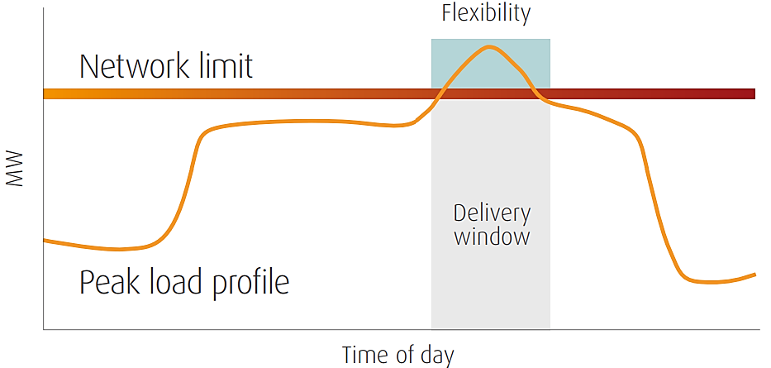



Problem
A need for energy flexibility
There is a need to enhance energy flexibility usage to meet peak hour energy demands efficiently. Sustain*, is 1 of 4 types of flexibility services defined by the ENA where the provider agrees in advance on their availability to deliver a change in export or import at specified time. It is a firm service providing a fixed revenue in return for the agreed reduction in peak load.
​Sustain flexibility plays a crucial role in peak demand reduction and helps to defer network reinforcement.
Peak load reduction through ‘Sustain’
There is a vast amount of centralised funding available to Local Authorities and Social Housing Providers such as the: Home Upgrade Grant, Social Housing Decarbonisation fund and ECO4 Flex, to undertake energy efficiency retrofits across their region.
These energy efficiency retrofits can provide Sustain flexibility but there is limited coordination between these social landlords (who represent a large portion of vulnerable customers) and the flexibility supply chain.
Extensive centralised
funding for efficiency upgrades
Low uptake of Energy Efficiency type Sustain flexibility due to limited awareness and constraints baselining. If these barriers are addressed, it would better align the supply chain and unlock wider system benefits for both the network and end consumers.
Uptake of energy efficiency flexibility
The Flex Direct solution
Flex Direct aims to develop novel commercial models and coordinated market approaches to enable direct participation of Local Authorities and Social Housing Providers into flexibility markets, increase the uptake of energy efficiency for flexibility and facilitate engagement of 'hard-to-reach’ customers at scale.
*Also known as Peak Demand Reduction

Slide 3
Engagement with local authorities and social housing providers
Longlist of 138 housing providers in licence area
16 known contacts shortlisted
Comms materials and interviews designed
Establish contact
Two additional referrals received
Eight interviews completed
BENEFITS | BARRIERS
Reduced energy bills for tenants and fuel poverty alleviation Greater energy awareness among tenants Increased tenant appetite for retrofits through providing evidence of reduced consumption Housing providers working towards Net Zero targets Evidence for future funding by demonstrating effective retrofit measures Consolidated relationship with UK Power Networks Financial reward received can subsidise future retrofit plans | Data protection concerns of monitoring data on tenants’ energy usage Tenant scepticism towards monitoring technology (e.g. smart meters) Resources (time and cost) required to measure, and evidence, demand reduction Retrofit measures that are out of scope for Flex Direct, e.g. electrifying heat and heat networks Risks associated with not being able to uphold the terms of the contract with UK Power Networks Sitting across the border of the UK Power Networks licence area and therefore not all properties qualifying
What is needed going forward?
Guidance on terms of the Flex Direct contract, which should avoid penalising providers for failing to reach targets
Clarity on what would constitute effective demand reducing measures that would be suitable for Flex Direct
Information on the level of financial reward available vs investment required to demonstrate reduced demand
Guidance on best practice for data sharing in relation to demonstrating demand reduction

Slide 4





Commercial arrangement options for Flex Direct
In Discovery, we have shortlisted three commercial arrangement options, each with varying stakeholder roles, responsibility and risk, to be explored for Alpha.
1. Enhanced business as usual Scenario
2. Direct contracting with local authorities
3. Direct contracting with local authorities, and wider supply chain
LA
FA
LA
LA
EMC
DSO
DSO
DSO
SHP
Minor adjustments to current Sustain flexibility process to encourage further participation from Local Authorities and Social Housing Providers.
Flexibility Aggregator is key party responsible
Activities include: increased marketing, longer contracts, alternative baseline approaches and amended competition timelines.
Direct procurement from Local Authorities, adapting processes to engage more participants driven by service improvement
Local Authority is key party responsible
Activities include: (addition to Option 1 activities) in-depth support and engagement with LAs to upskill and determine incentive levels, contractual clauses amendments regarding under-utilisation.
Direct procurement with private stakeholder support, emphasizing commercial viability and scalability through increased costs and expertise.
Activities include: (addition to Option 1 activities) some upskilling support, reviewing of service fees, contractual clauses amendments regarding under-utilisation, sub-contracting and governance
Score
Score
Score
Alignment to DSO / RIIO- ED2 requirements:
Alignment to DSO / RIIO- ED2 requirements:
High
Alignment to DSO / RIIO- ED2 requirements:
High
High
Impact (benefit and scalability):
Medium
Impact (benefit and scalability):
High
Impact (benefit and scalability):
High
Complexity to Deliver (time and cost):
Medium
Complexity to Deliver (time and cost):
Medium
Complexity to Deliver (time and cost):
Medium
Risk (to delivery and competition):
Low
Risk (to delivery and competition):
Medium
Risk (to delivery and competition):
Medium

Slide 5























Partnership ecosystem approach
Key stakeholders across the energy efficiency and flexibility supply chain were mapped to determine whose business needs and likely level of influence could lead to favourable outcomes for Flex Direct
Local Authorities and social housing providers
Key questions to consider
Energy Management Companies
DSOs
Which stakeholders’ business needs align most strongly with provision of flexibility from Energy Efficiency to increase the likelihood of favourable outcomes for the network and end-consumers?
Flexibility providers/
aggregators
Trade associations and industry groups
Utilities and energy suppliers
NGOs and advocacy groups
Which stakeholders are key decision makers within the energy efficiency and flexibility supply chain who could readily mobilise solutions that will target the increased provision of energy efficiency flexibility?
Research Institutions & Think Tanks
Government Agencies & Regulatory Bodies
Which stakeholders are likely to bring a greater level of impact, and lower level of risk to this initiative?
Energy efficiency service providers
Community Energy Groups
KEY
Financial institution and investors
Manufacturers and suppliers of energy-efficient technologies
Tier 1: Tier 2: Tier 3:

Slide 6
Key takeaways
Unlikely organic growth
Energy efficiency flexibility in its current form is unlikely to lead to organic uptake, by the market, due to limited awareness, insufficient incentive levels and a lack of co-ordination between key stakeholders across the supply chain.
The importance of Local Authorities
In the Flex Direct Partnership Ecosystem, Local Authorities (with or without Flexibility Aggregators) will play a crucial role in delivering energy efficiency flexibility, by leveraging substantial government subsidies for retrofits. Findings from Work Package 1 and 2 indicate Local Authorities’ clear interest in participation but highlight the need to reassess current commercial arrangements to address concerns and enhance commercial viability.
Presently unfeasible arrangements
Considering present Sustain service fees and contract durations, the resourcing costs required for a Local Authority, a relatively inexperienced new market entrant, presently outweigh the revenue earnt by meeting the contract terms and providing agreed volumes of peak demand reduction to the DSO directly.
DSO to take the lead
If current commercial arrangements for energy efficiency sustain flexibility remain unchanged, the DSO would need to take the lead, providing knowledge sharing and upskilling support to supply chain stakeholders to enable direct participation in flexibility markets.

Slide 7
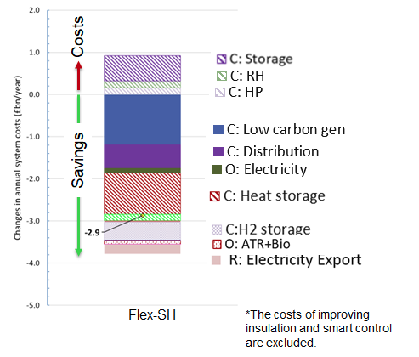
Benefits assessment of scaling up
Potential savings of social houses’ energy efficiency improvement and participation in flexibility services that can be harnessed through Flex Direct
Impact of deferral of distribution network reinforcement and related environmental benefits of rolling-out the Flex Direct approach
Approach
Consumer Transformation scenario
Region | 10-year NPV (£m) | Whole Life NPV (£m)
UK Power Networks | 110 | 72
GB DNOs | 315 | 207
Load Related Expenditure model
Local district level
Per social house
Region | 10-year NPV (£) | Whole Life NPV (£)
UK Power Networks | 78 | 51
GB DNOs | 64 | 42
Integrated Whole-Energy System model
Hydrogen
Natural gas
Heat
Electricity
Assumptions and other input data are described in the next slide.
Savings in low-carbon generation investment, deferral of distribution network reinforcement, electricity OPEX, heat storage, and other flexibility technologies.

Slide 8
Peak Demand Reduction (LRE input)
Sources: England, Welsh and Scottish governments: social housing stock, and LSOA/DZ and local authority lookup
Office for National Statistics and Scottish Government: OA, LSOA, and DZ boundary map
The NG ESO: GIS boundaries for GB DNO licence regions
Rightmove’s energy bill tracker (used as a proxy for peak reduction)
Assumptions
Resistive heating replaced with heat pumps
Three year network planning horizon
All social hosing providers participate in Flex Direct
Constant efficiency implementation over years
All social houses are EPC-C by 2028
Social housing stock per local authority area
DNO regions
https://www.rightmove.co.uk/news/articles/property-news/average-uk-energy-bills-how-to-save-money/
Average peak reduction is approx. 32%
https://www.wardhadaway.com/insights/updates/social-housing-speed-read-the-impact-of-the-scrapped-epc-policy-on-the-social-housing-sector/
Social housing stock per DNO area
Percentage of social homes per EPC rating
Percentage of social homes rated EPC D-F is 44%
Peak demand reduction per DNO area
Network planning
Average ADMD is 2.82 kW
Time horizon for implementing peak reduction in network planning
Counterfactual: three years
Flex Direct: immediately
UK Power Networks, EDS 08-2000
Typical after diversity maximum demand (ADMD)

Slide 9
Next steps
We aim to continue developing the identified novel commercial models and coordinated market approaches to enable direct participation of Local Authorities and Social Housing Providers into flexibility markets, increase the uptake of energy efficiency for flexibility and facilitate engagement of 'hard-to-reach’ customers at scale.
If a large-scale energy efficiency trial is successful for both DSO and the housing provider, this can help to stimulate market-awareness as well as provide clarity on appropriate contractual duration and payment reward regimes.
1
Further engagement with stakeholders identified in the Partnership Ecosystem to refine requirements for participation, and identify enablers for Local Authority uptake
2
Further analysis of current commercial options proposed at Discovery, refine and then testing with stakeholders
3
Explore potential approaches to baselining peak consumption to improve market confidence in energy efficiency flexibility

Slide 10
Questions

